Slide 1
Conducting subjective and objective assessment
LO: Effects of anatomy, physiology and pathology on human function

Slide 2
Assessment criteria
LO5: Understand the effects of anatomy, physiology and pathology on human function
Describe the characteristics of common postural types
Explain the effects of postural deviations
Describe the pathophysiology of common injuries/soft tissue dysfunction
Explain how the ageing process affects the musculoskeletal systems

Slide 3
Activity
Describe ‘optimal’ posture.

Slide 4
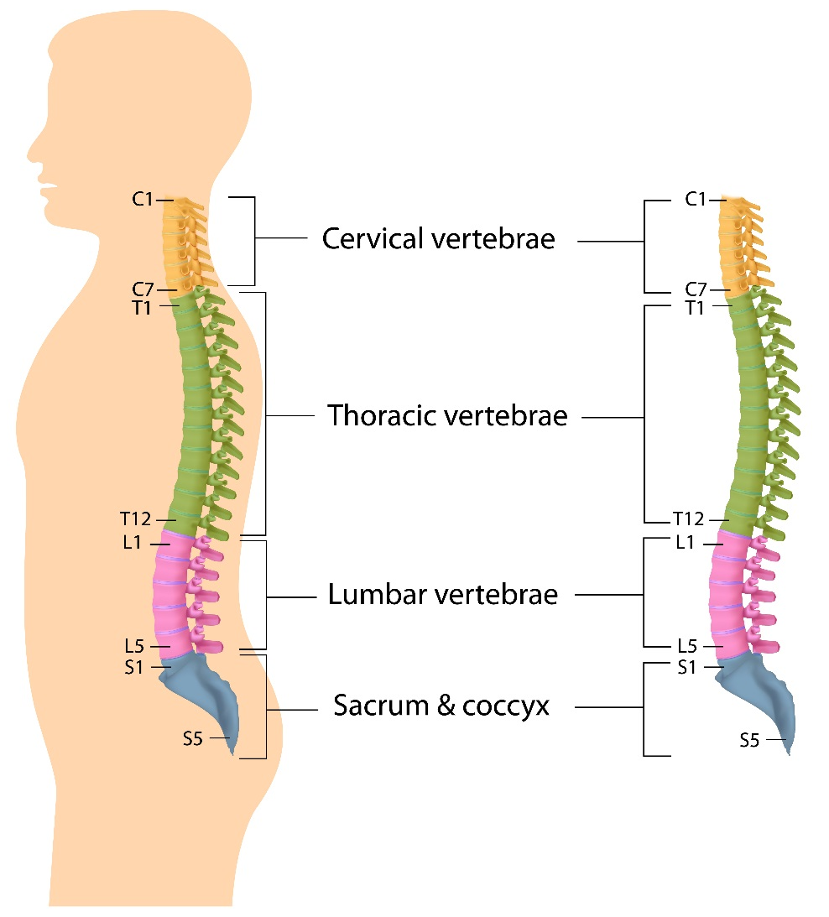
Neutral alignment

Slide 5
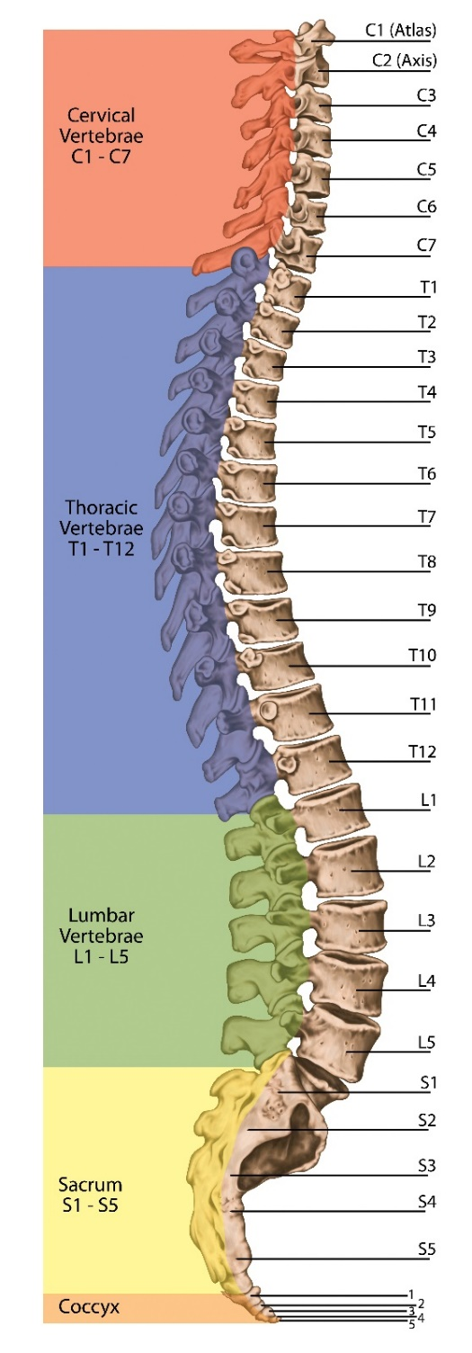
The spine
When viewed from the side, e.g. a postural assessment; three distinct curves can be observed:
Cervical lordotic (secondary)
Thoracic kyphotic (primary)
Lumbar lordotic (secondary)

Slide 6
Static posture
Side view
Plumb line:
Anterior to lateral malleolus (ankle)
Midline of knee
Greater trochanter (hip)
Pelvis – ASIS and PSIS
Lumbar spine
Thoracic spine
Midline shoulder (acromion process)
Ear lobe
Crown of head

Slide 7
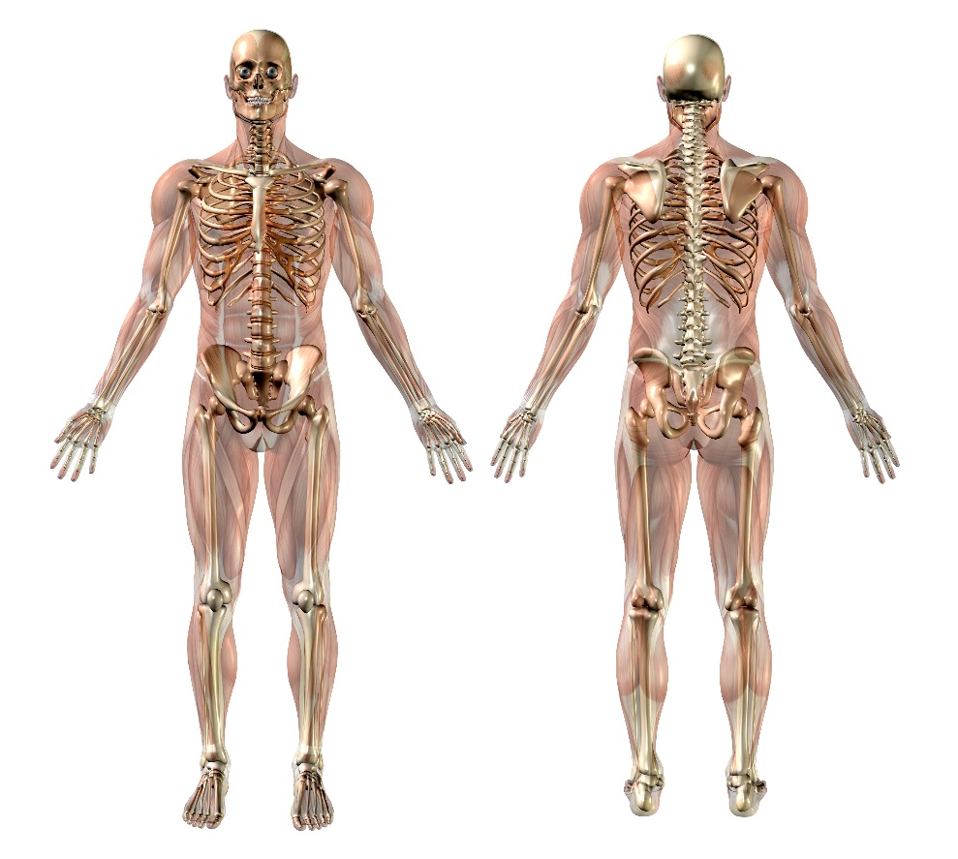
Static posture
Posterior
Check symmetry:
Head
Shoulders
Scapula positioning
Waist creases
Hips
Feet turn out
Muscle bulk
Arch of foot-supinated/pronated

Slide 8
Static posture
Anterior
Check symmetry:
Head
Shoulders
Hips
Knee over 2nd/3rd toe
Feet turned out
Arch of foot - supinated/pronated

Slide 9
Activity
Name common postural deviations
Describe the characteristics of common postural types
Explain the effects of postural deviations

Slide 10
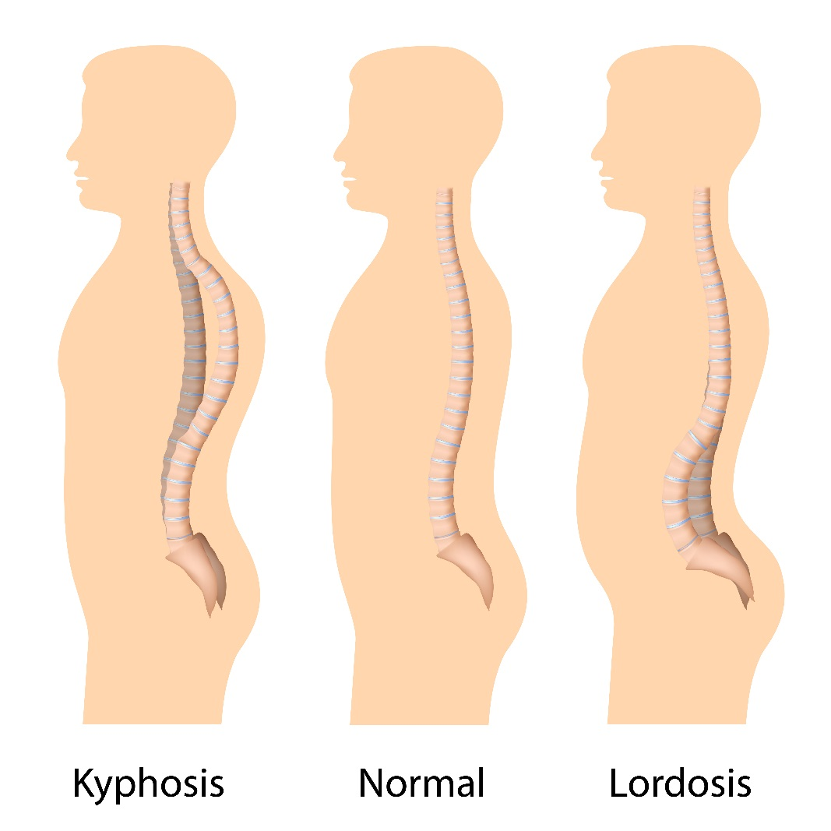
Postural deviations
Hyperlordosis
Hyperkyphosis
Flat back
Sway back
Winged scapula
Scoliosis
Dowagers hump

Slide 11
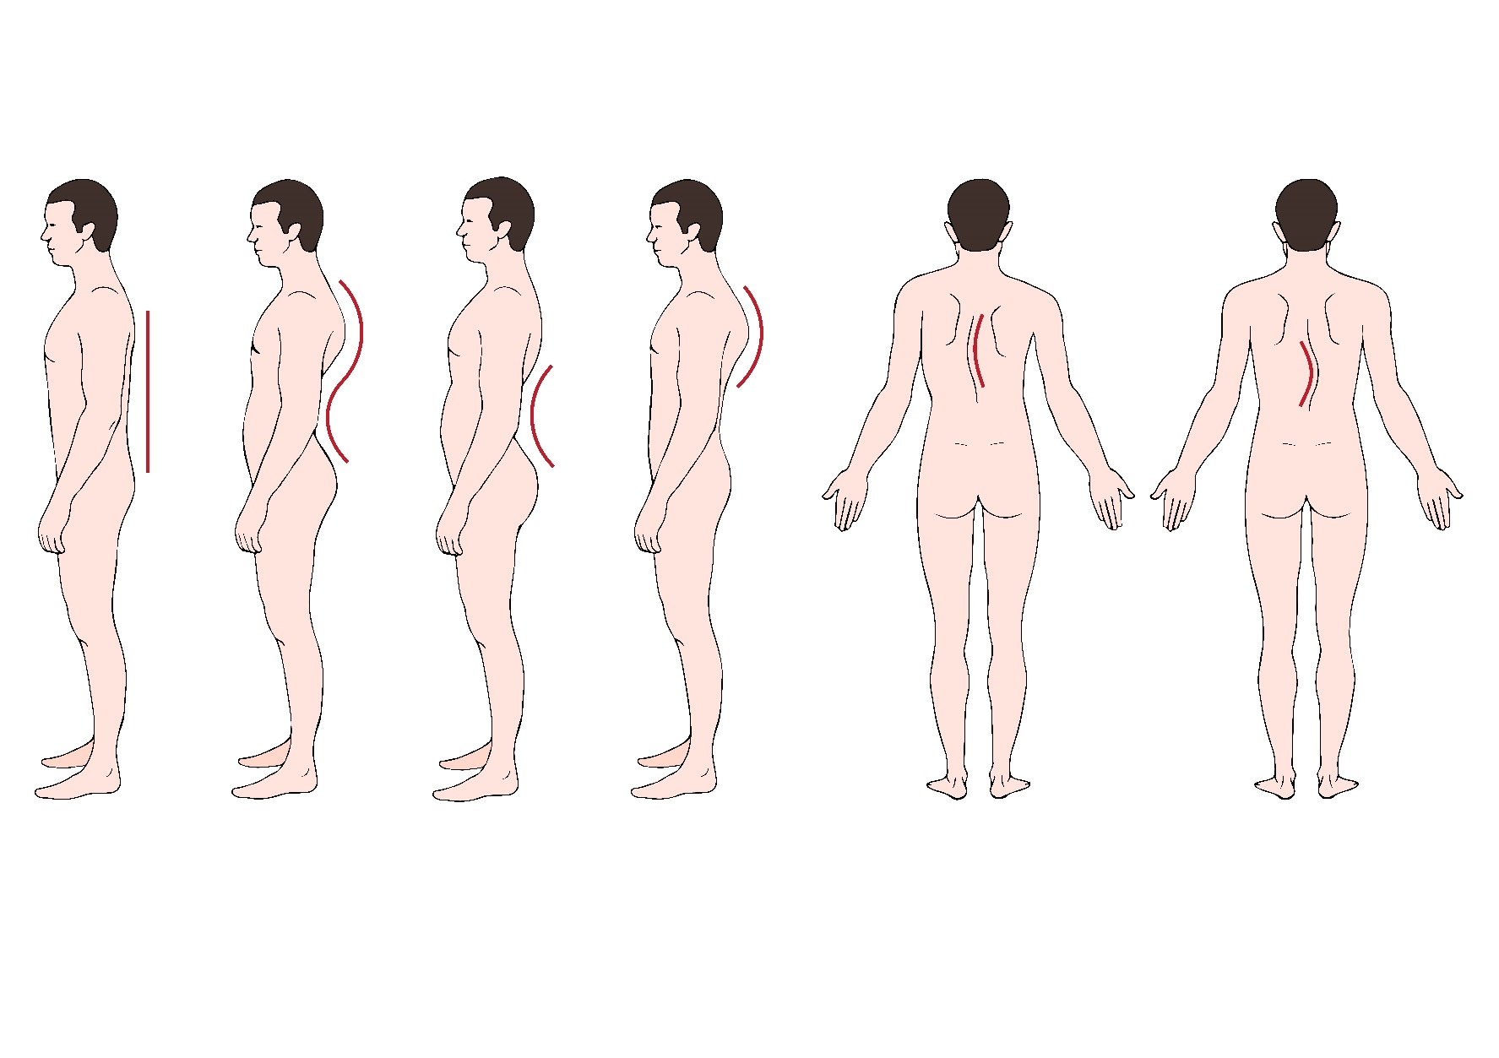
Postural deviations
Hyperkyphosis/Hyperlordosis
Hyperkyphosis
Scoliosis
Flat back
Hyperlordosis

Slide 12
Posture types
 | Weak/long muscles | Short/tight muscles | Action
Hyperlordosis | Hamstrings Gluteals Abdominals | Back extensors (possibly) Hip flexors | Stretch short muscles. Strengthen weaker muscles.
Hyperkyphosis | Lower and middle trapezius Rhomboids Neck flexors | Neck extensors Pectorals Anterior deltoid Upper trapezius
Flat back | Hip flexors Back may be long but not necessarily weak | Hamstrings Possibly abdominals
Sway back | Hip flexor External obliques Upper back extensors Neck flexors | Hamstrings, Internal oblique Lumbar extensors (may be strong, but not short)
Scoliosis | One side convex | Other side concave

Slide 13
Hyperlordosis
Lower crossed syndrome
Potential contributory factors and causes
Genetics
Pregnancy, e.g. baby weight and lengthening of RA muscle
Occupation
Lifestyle
Obesity – abdominal adiposity
Sport, e.g. gymnastics (hyperextension)
Over-compensation related to a past injury

Slide 14
Hyperlordosis
Lower crossed syndrome
Assessment
General lower back pain
No obvious cause
Excessive lumbar curve
Anterior pelvic tilt
Short/overly tight - iliopsoas, erector spinae, rectus femoris, adductors, TFL, QL
Lengthened/inhibited - rectus abdominis, erector spinae, multifidus, gluteus maximus and medius, hamstrings
Treatment
Soft tissue techniques and stretching to lengthen short muscles
Strengthen inhibited muscles
Determine cause
Provide preventive advice or treatment

Slide 15
Hyperkyphosis
Upper crossed syndrome
Potential contributory factors and causes
Sedentary occupation, e.g. driving, desk work
Lifestyle
Sport activities, e.g. cycling
Over-compensation related to a past injury

Slide 16
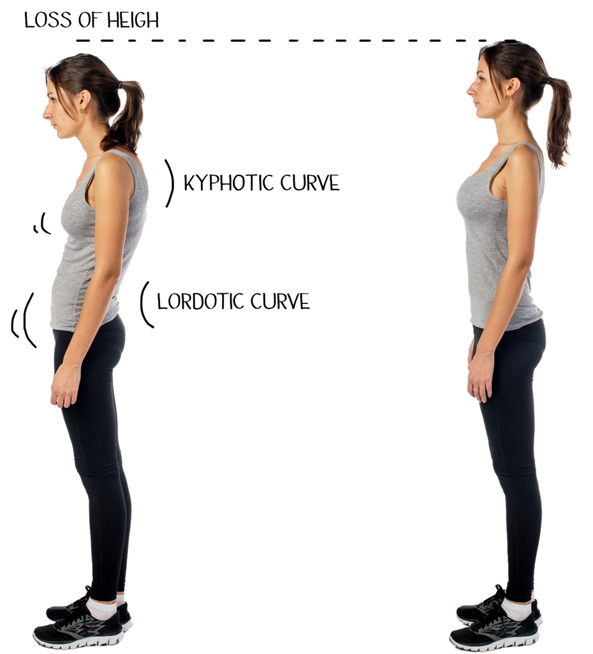
Plumbline

Slide 17
Hyperkyphosis
Upper crossed syndrome
Assessment
Headaches, neck or shoulder pain
Rounded shoulders
Excessive kyphotic curve
Excessive cervical lordotic curve
Shortened and tight - levator scapula/upper trapezius, pectoralis major/minor
Lengthened and weak - rhomboids, trapezius (middle and lower), serratus anterior
Treatment
Soft tissue techniques and stretching to lengthen short muscles
Strengthen inhibited muscles
Aim to determine causal factors
Provide preventive advice or treatment recommendations

Slide 18
Scoliosis
Lateral deviation of the vertebral column
Potential contributory factors and causes
Heredity/genetic factors
Lifestyle, e.g. heavy lifting or carrying on one shoulder
Occupation
Sport activities, e.g. racket sports
Restriction or compensation from previous injury

Slide 19
Scoliosis
Assessment
Lateral deviation of the spine visible
Ipsilateral shortening of erector spinae and linked muscles
Contra lateral lengthening of erector spinae on opposite side
Localised pain
Secondary effects may include pressure on other structures or organs
Treatment
Soft tissue techniques and stretching to lengthen short muscles
Strengthen inhibited muscles
Aim to determine cause – signpost to GP if any consequential factors identified
Provide preventive advice or treatment

Slide 20
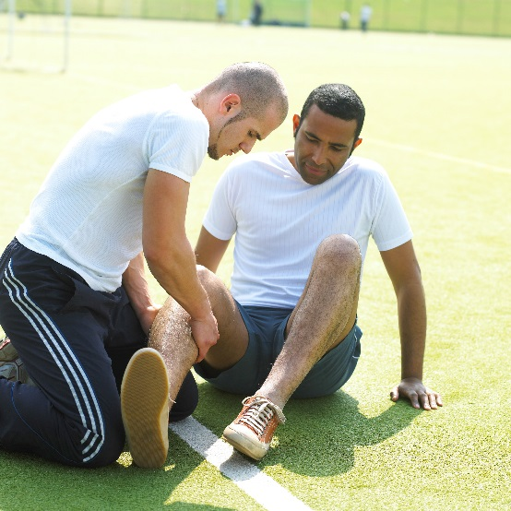
Activity
Describe the pathophysiology of common injuries/soft tissue dysfunction

Slide 21
Types of soft tissue injury
Strains – muscle and tendon
Sprains – ligament
Overuse – tendinopathy
Skin – cuts, abrasions, blisters. Friction burns
Contusions and haematoma - inter and intramuscular
Bursa – bursitis
Related conditions:
Muscle cramp
Delayed onset muscle soreness (DOMS)

Slide 22
Strains - muscles and tendons
Severity of injury graded as:
Grade 1 – mild: occurs when < 5% of muscle fibres are damaged, minor pain, swelling , minimal loss of function
Grade 2 – moderate: more extensive damage to fibres, pain and weakness more pronounced
Grade 3 – severe: total rupture/tear, damage to > 95% of fibres, more significant swelling, loss of function

Slide 23
Sprains - ligaments
Severity of injury graded as:
Grade 1 - minimal damage, minor swelling, pain
Grade 2 - partial rupture/tear, joint laxity, some instability, moderate to severe pain
Grade 3 - total rupture, severe pain and swelling, loss of joint stability

Slide 24
Overuse injuries
Tendinopathy – generic term for painful conditions that affect tendons, including:
Tendonitis – inflammation and swelling
Tendinosis – degeneration of the tendon’s collagen in response to overuse
Tenosynovitis – inflammation of the synovium of tendons within their synovial sheath (typically in the wrist)
Bursitis – swelling of a bursa (small, fluid-filled sacs that provide cushioning between bones and tendons) due to overuse but may be due to acute direct trauma

Slide 25
Muscle cramp
Spasm and tightness in a muscle
Comes on suddenly
Can be excruciatingly painful
Visible lump appears
Can be alleviated by stretching and massage
Possible causes (none definitive):
Tight/short muscles
Low sodium levels
Dehydration
Glycogen depletion

Slide 26
Injuries to the skin
Graze - caused by friction, usually superficial
Cut - caused by something sharp penetrating through the skin
Burn - caused by fire, chemicals, electricity. Different degrees of burns, can be severe

Slide 27
Delayed onset muscle soreness
Discomfort, soreness and stiffness
No sharp or acute pain
No visible inflammation
Onset of symptoms delayed, not immediate:
Present 1-2 days after training
Can last 3 days
History - usually caused by unfamiliar eccentric loading or exercise, high intensity or unfamiliar exercise
Proposed mechanisms (none definitive):
Damage to myofibrils
Inflammation and oedema
Muscle spasms

Slide 28
Contusions
Caused by an external blow or impact to the muscle
Leading to disruption of the muscle fibres and their vascular supply
Bruising observed
The bleeding and swelling associated with a contusion is usually referred to as a haematoma
Intramuscular haematomas - blood into the body of the muscle affected by the impact
Intermuscular haematomas - blood between the muscles and fascia

Slide 29
Fractures
Open – skin broken
Closed – skin not broken
Complicated – associated complications
Greenstick – bone bends and fractures, typically in young, soft bone

Slide 30
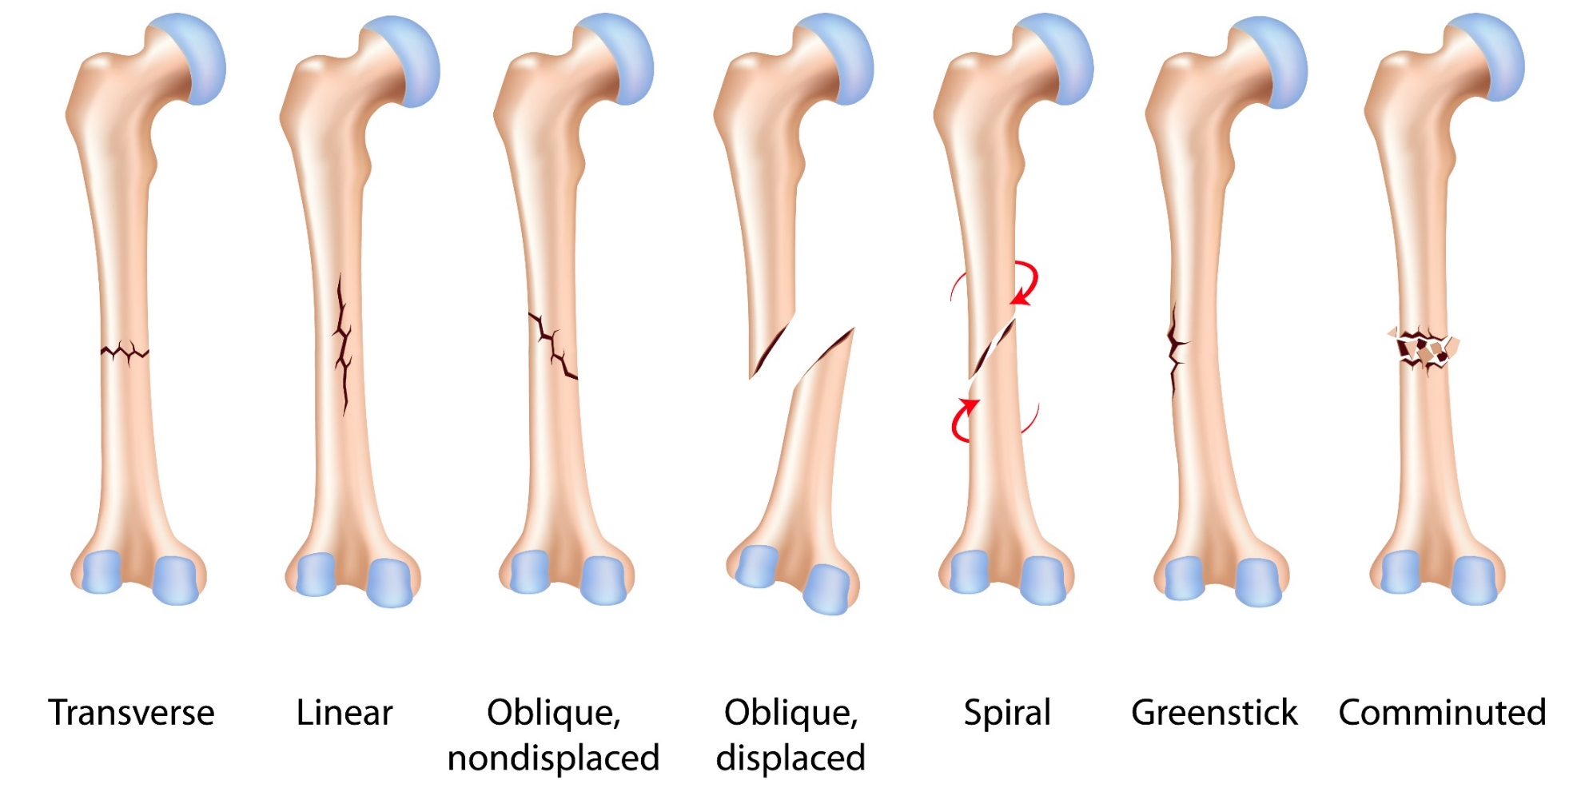
Types of bone fractures

Slide 31
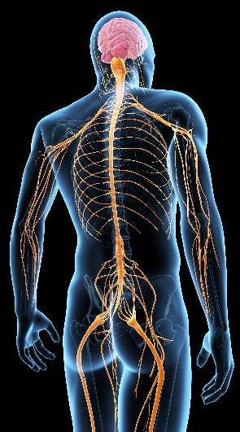
Nerve damage
Neuropathy
A term used to describe problems with the nerves, particularly the peripheral nerves.
Neuropraxia - temporary loss of sensation and function due to bruising or compression of a peripheral nerve
Neurotmesis - severe injury to nerve, often resulting in permanent impairment. Affects whole nerve

Slide 32
Causes of injury
Injuries can be:
A specific trauma or direct impact/blow to an area (intrinsic or extrinsic) – Primary injury
Other injuries that occur in response to, or as a consequence of the original injury, e.g. from compensatory movements or postural changes – Secondary injury
Not caused by any direct trauma. Can occur in response to other conditions that increase potential risk of injury, e.g. knock knees, bow legs - Non-consequential injuries

Slide 33
Intrinsic
Relate to innate/internal anatomical and physiological factors:
Muscle weakness
Muscle tightness
Muscle length/flexibility/inflexibility
Joint laxity/stiffness
Excessive Q-angle
Muscle imbalances
These are all contributory factors to overuse injuries.

Slide 34
Intrinsic
Relates to factors that are external and outside of an individual’s control:
Collisions – direct contact with another competitor or object during a game or tournament, e.g. basketball, rugby, ice hockey
Accidents – dropping a weight on the toes, trapping finger in weight stack
Clothing and footwear – chafing, ineffective protective equipment (gum shield/helmets)
Environment – uneven floor surface (running on grass), hard floor surface and impact forces (e.g. running on concrete pavement); temperature

Slide 35
Activity
Why is it useful for a sports massage therapist to know the cause of an injury?

Slide 36
Benefits of knowing cause of injury
To advise on risk management and injury prevention
To prevent further injuries or recurrence
To enable treatment and consideration of all factors that impact on functioning and range of movement (e.g. pain, tightness etc.)
To identify any need for referral (e.g. physiotherapist)
To restore function

Slide 37
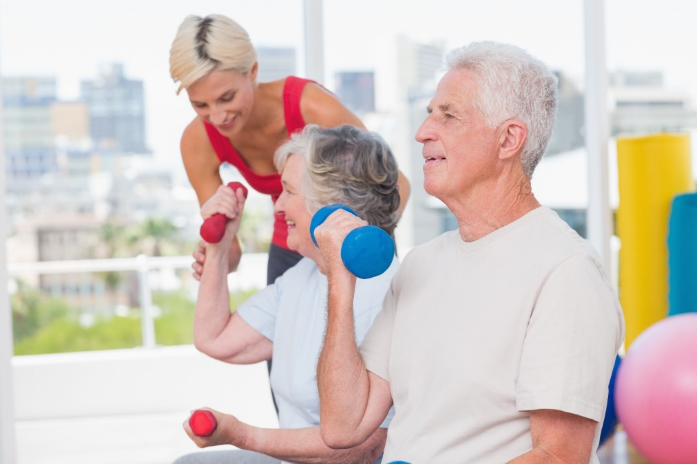
Activity
Explain how the ageing process affects the musculoskeletal systems

Slide 38
Older adults
The ageing process is highly individual
People age at different rates
Progressive decline in functioning of body systems
Effects to: mobility, independence, risk of chronic health conditions, level of frailty and risk of falls
Activity assists functioning
Effects generally start around the age of 50
By age 65, effects more apparent
Older adult classifications (ACSM 2014)
Aged 50-64 with physical limitations or chronic health conditions
Aged 65 and over

Slide 39
Cardiovascular and respiratory
Reduced efficiency of cardiovascular and respiratory systems Reduced stroke volume and cardiac output Reduced intake and utilisation of oxygen Increased blood pressure Less capillaries Less elastic vessels Increased risk of CVD | Lower maximal and target heart rate Decreased anaerobic threshold Reduced tolerance to high intensity exercise Fatigue quicker Take longer to recover
Source: Lawrence, 2008

Slide 40
Neuromuscular
Less fast twitch muscle fibres Reduced motor neurons Decreased neuromuscular transmission Fewer capillaries Increased connective tissue Decline in vision Decline in hearing Decline in cognitive function | Reduced: Muscular endurance, strength and power Movement speed Range of motion and flexibility Coordination and balance Postural stability Short-term memory
Source: Lawrence, 2008

Slide 41
Skeletal
Reduced bone density Loss of bone mass Increased risk of osteoporosis Reduced synovial fluid Calcification of cartilage in the joints Increased risk of osteoarthritis Thinning of joint capsule Thinning of articular cartilage Reduced elasticity in ligaments and tendons | Bones more susceptible to fracture Joints less mobile and stiffer Reduced shock absorption capacity in the joints
Source: Lawrence, 2008

Slide 42
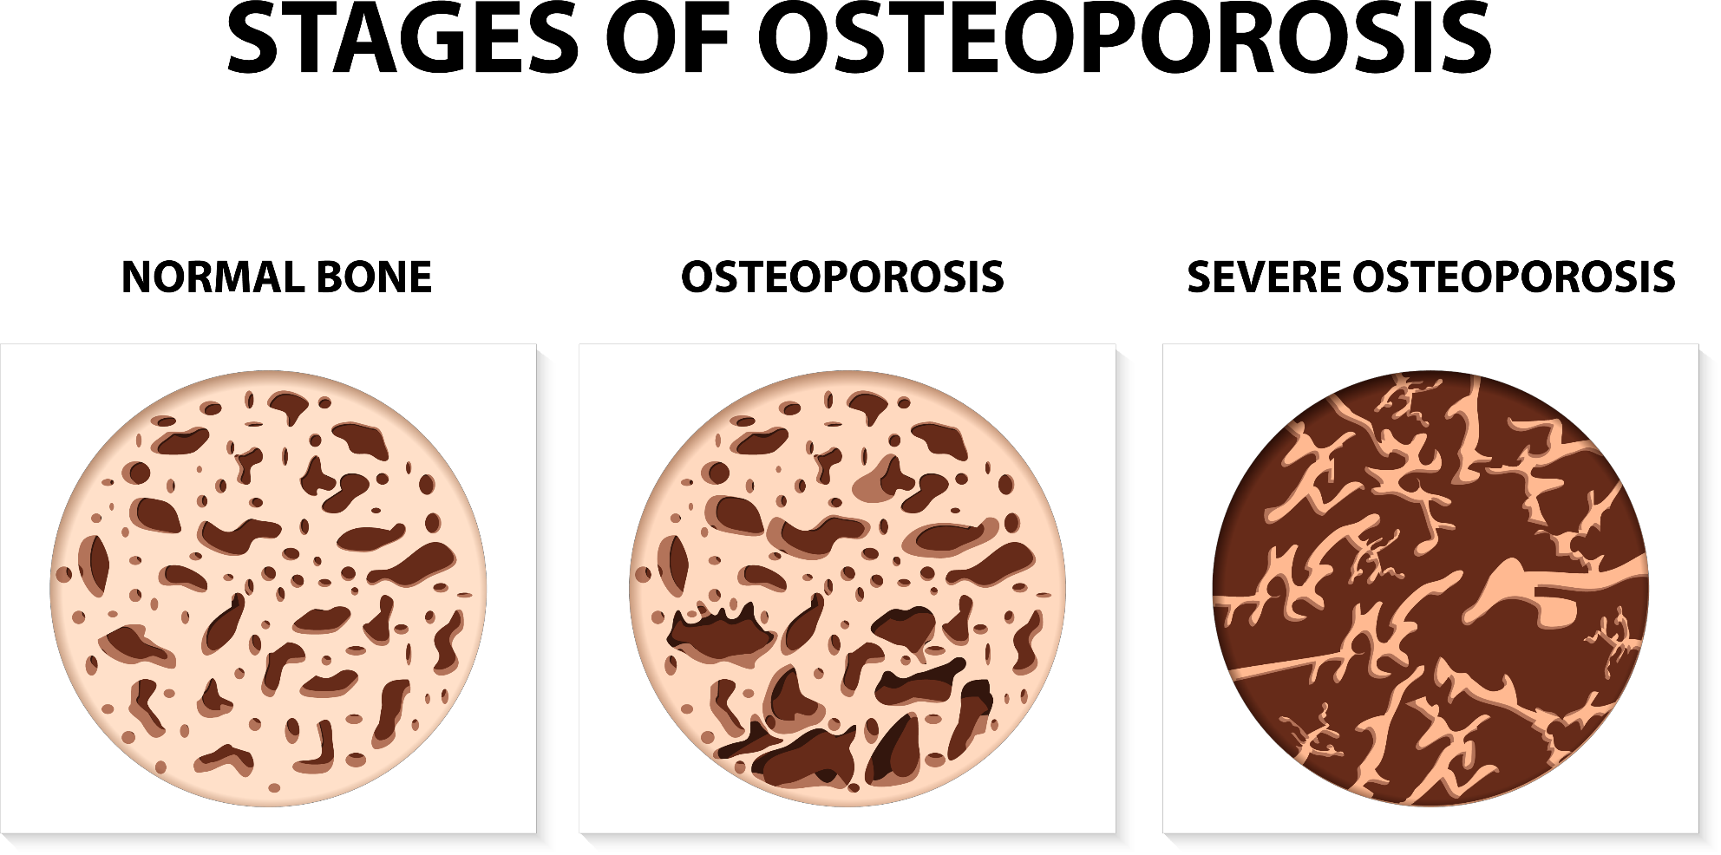

Slide 44
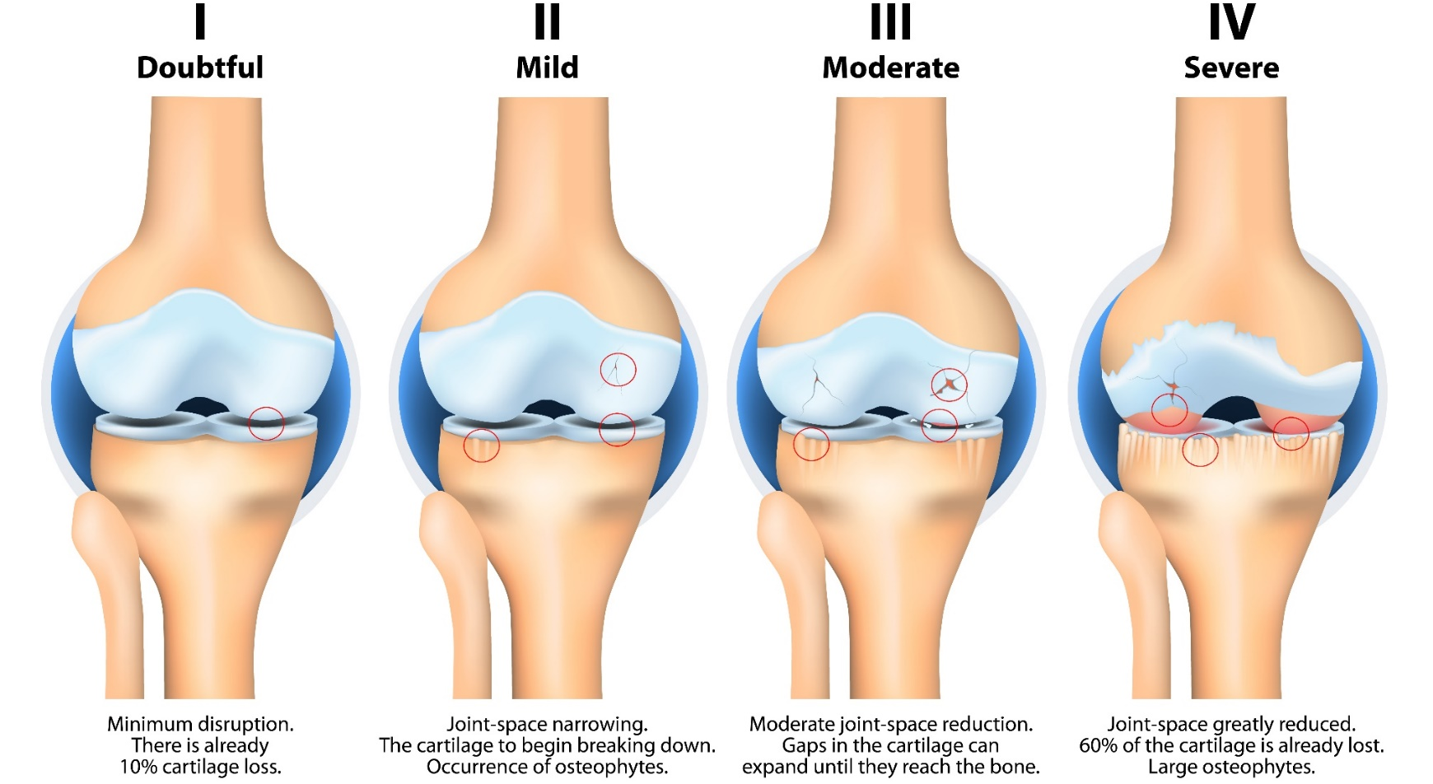
Progression
Stage of knee osteoarthritis

Slide 46
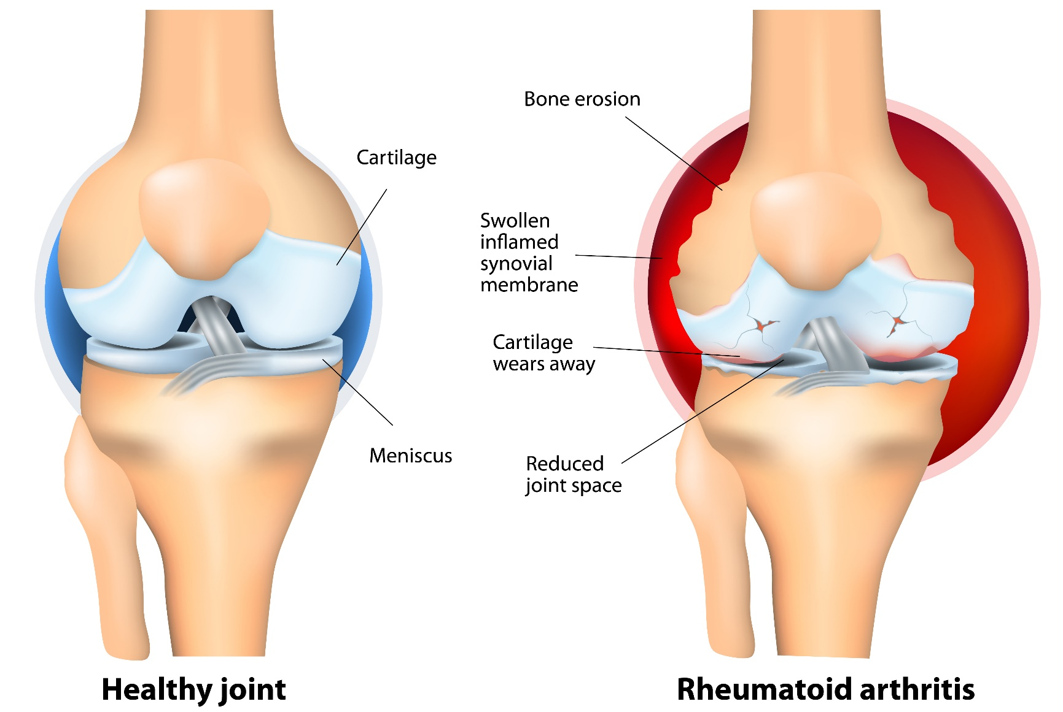
Rheumatoid arthritis

Slide 47
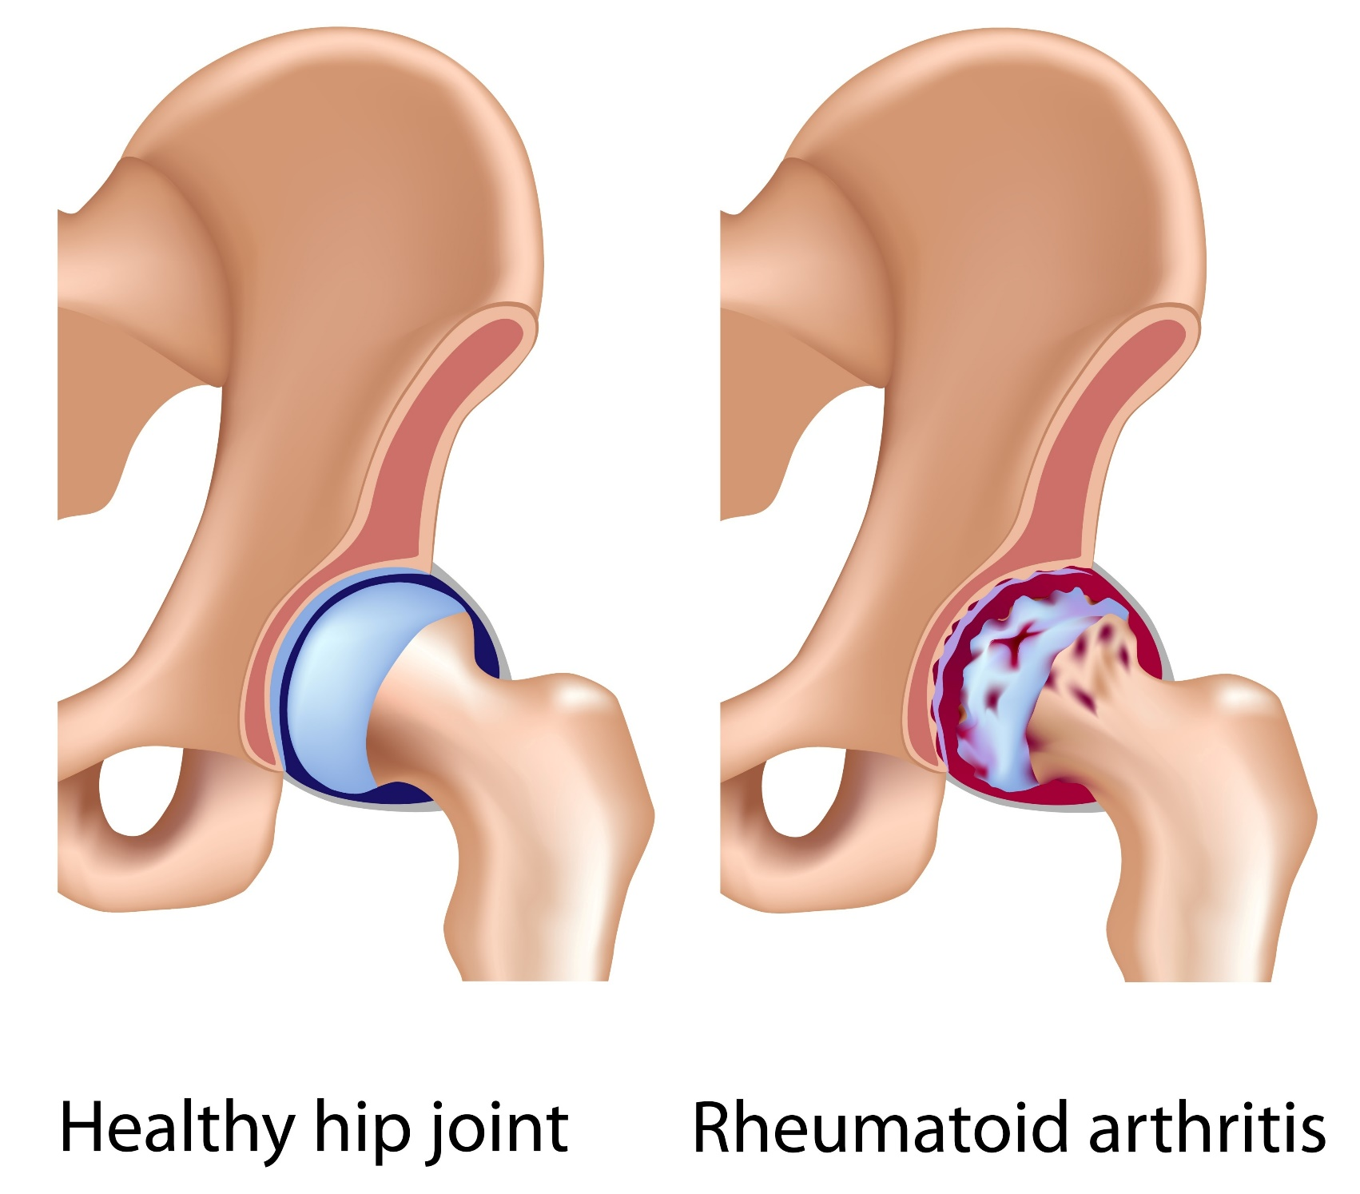

Slide 48
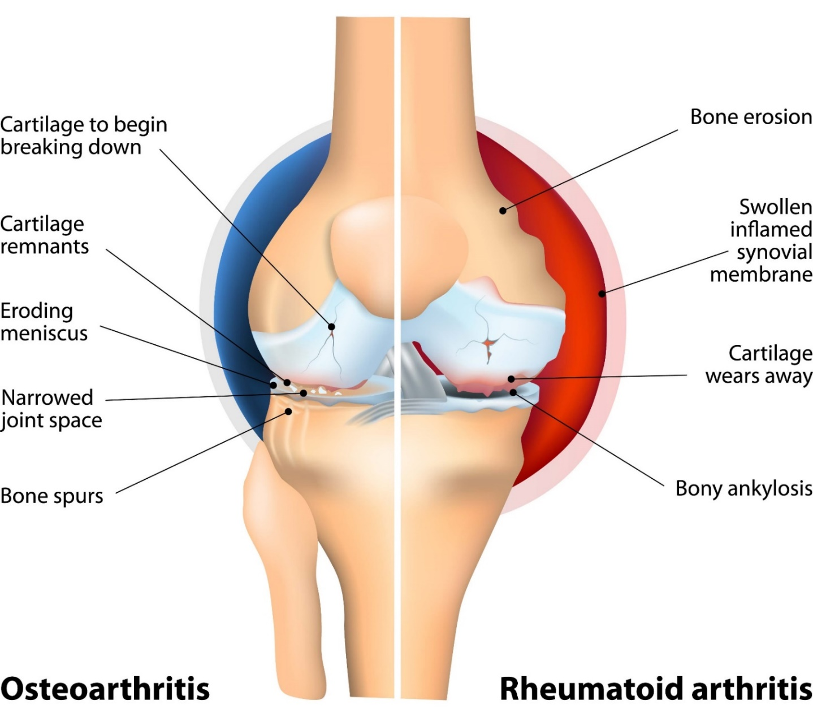
Differences between OA and RA

Slide 49
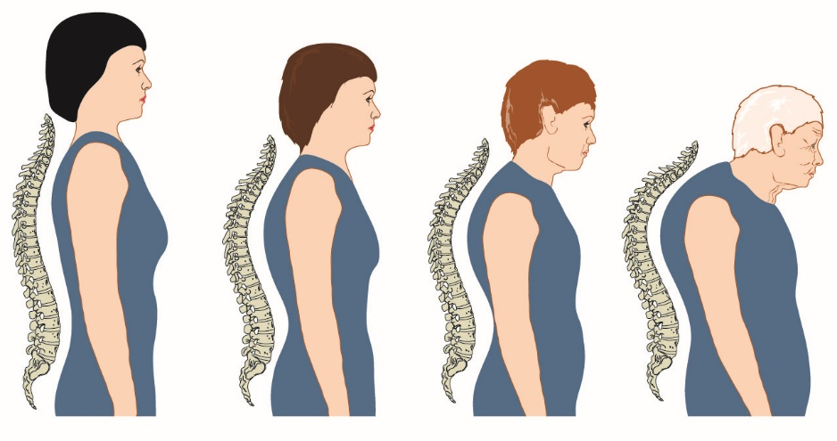
Posture and ageing
Notes:
ID: 30727550
Copyright Gunther von Hagens, Institute of Plastination, Body Worlds exhibition

Slide 50
Sarcopenia
Loss of muscle mass
Reduced muscle strength
Functional ability and performance affected
Significant impact on activities of daily living

Slide 51
Learning check
Describe the characteristics of common postural types
Explain the effects of postural deviations
Describe the pathophysiology of common injuries/soft tissue dysfunction
Explain how the ageing process affects the musculoskeletal systems

