Slide 1
Planning exercise referral programmes
LO: How to prepare for exercise referral

Slide 2
Assessment criteria
Describe a range of resources required to deliver exercise referral programmes for individuals and groups, including:
environment for the session
portable equipment
fixed equipment
Explain how to work in environments that are not specifically designed for exercise/physical activity

Slide 3
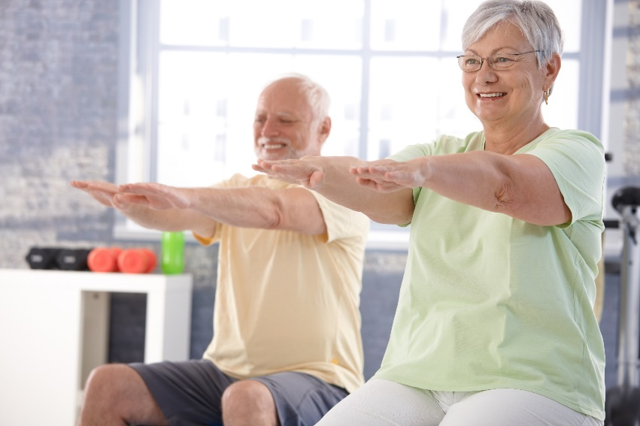
Activity
What resources would be required to deliver exercise referral programmes for individuals and groups?
Consider:
environment for the session
portable equipment
fixed equipment

Slide 4
Environments
Leisure centre
GP surgery
Community hall
Client home
Gym
Outdoor area, e.g. park
Swimming pool
Dance studio
Which environments are specifically designed for exercise?

Slide 5
Resources
Will depend on setting:
Gym or leisure facility:
CV machines
Resistance machines
Free weights
Swimming pool:
Woggles
Waterbells
Gloves and paddles
Floats
Community or home settings
Bands, hand weights
Steps
Stability equipment
Chairs

Slide 6
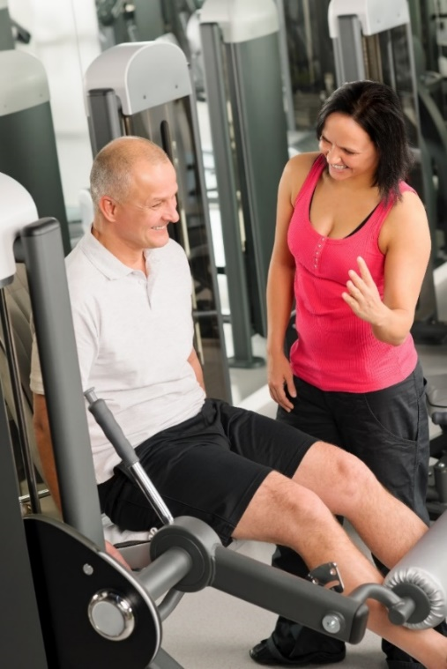
Instructors
Team of instructors working on a check must be qualified to instruct a range of specific activities to meet different client needs:
Gym-based
Pool based
Studio based
Outdoors
And qualified to work with specific conditions:
Exercise referral
Older adults
Disabled adults
Specialist conditions
Falls
Cardiac rehab
Mental health
Low back pain
Obesity and diabetes

Slide 7
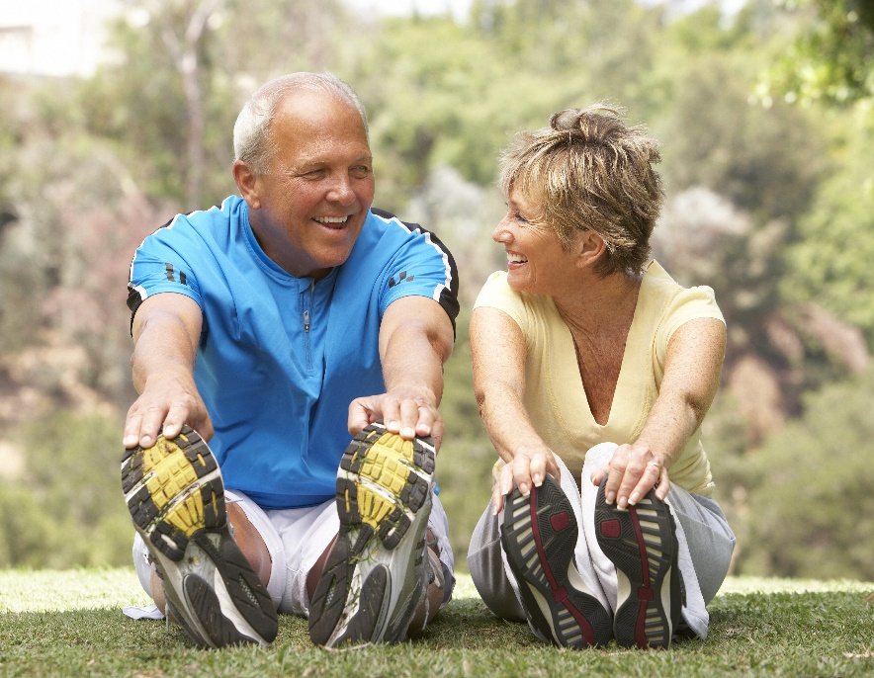
Activity
What would need to be considered before working in environments that are not specifically designed for exercise/physical activity?

Slide 8
Environment considerations
Check organisation procedures, e.g. health and safety or devise own, e.g. for clients home
Personal insurance and centre insurance
Conduct risk assessment of environment
Space, e.g. for number of clients
Temperature or weather if an outdoor environment
Floor surface
Accessibility
Availability of drinking water
Nearest telephone and emergency contact numbers
Availability of first aider and first aid kits
Emergency exits, emergency contacts

Slide 9
Client considerations
Check screening records
Verbal screening at all sessions
Check they have medication, e.g. asthma inhalers
Instructor can carry these or place in safe location
Client administers own medication
Appropriate time of day for their condition
Some conditions less symptomatic later in the day, e.g. respiratory
Less crowded environments help some conditions, e.g. anxiety

Slide 10
Equipment considerations
Health, safety, hygiene and maintenance of equipment
Appropriate amount of equipment for number of users, e.g. mats, handweights
Induction or training required to use equipment
Any technical skills to operate or use equipment
Any base level of fitness required to use equipment
Level of supervision required
Portability of equipment if moving between locations
Cost of equipment

Slide 11
Learning check
Describe a range of resources required to deliver exercise referral programmes for individuals and groups, including:
environment for the session
portable equipment
fixed equipment
Explain how to work in environments that are not specifically designed for exercise/physical activity

