Slide 1
Lesson 7 - Nutritional requirements for pre and postnatal clients.

Slide 2
Learning objectives
By the end of the lesson you will be able to:
Explain the importance of a balanced diet for pre and postnatal clients
Identify important food sources and explain their value to pre and postnatal clients.
Identify foods to be avoided during pregnancy and explain the reasons why they should not be consumed
List the vitamin and mineral supplements recommended in pregnancy, and explain the benefits of each
Explain the importance of hydration for pre and postnatal clients

Slide 3
Phsyiological and biomechanical changes
Activity
Discuss and list the five food groups included in the UK Eatwell Guide and the rationale behind consuming or limiting each food group in pregnancy.
Also list any other recommendations made by the UK Eatwell Guide and discuss its relevance in pregnancy.

Slide 4
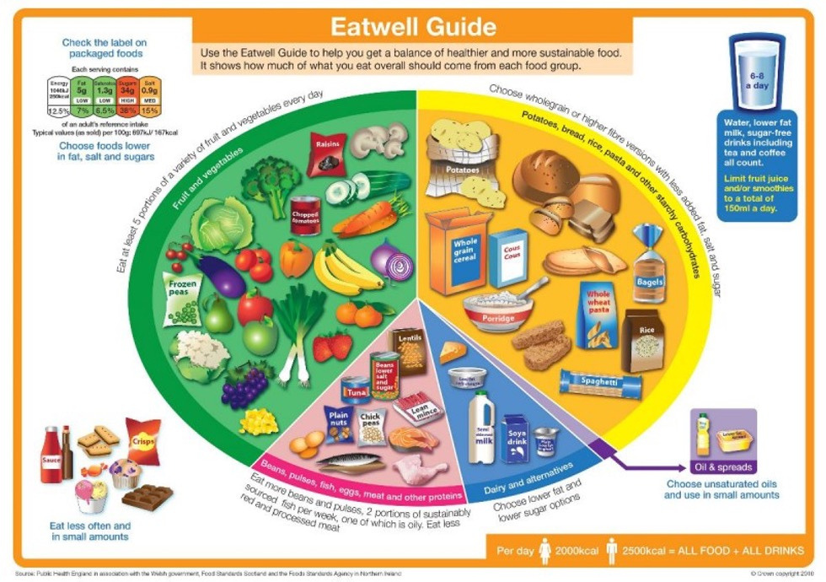
A balanced diet - the UK Eatwell Guide

Slide 5
Important food sources in pregnancy
Fruit and vegetables, at least five portions per day (fresh, frozen, canned, dried or juiced). | Starchy carbohydrates should make up just over one-third of the food we eat.
Provide a varied range of vitamins and minerals. Also, they should contain fibre, which aids digestion and helps to prevent maternal constipation. | Provide some vitamins and fibre. They are also a good source of energy, as both pre and postnatal women will experience periods of fatigue or tiredness.

Slide 6
Important food sources in pregnancy
Protein such as beans, pulses, fish, eggs (Lion Code), poultry, nuts and meat; ensure that meat is well cooked. Eat fewer processed meats such as burgers, sausages and bacon. | Dairy food such as milk, yogurt, fromagé frais, cream and some cheeses (see list of foods to avoid for certain cheeses). Non-dairy options such as soya and almond should be unsweetened, calcium-fortified versions.
The amino acids that make up protein are the building-blocks of our body’s cells and the baby’s body as well. It is especially important in the second and third trimesters when a baby is growing fast. | An important source of calcium and other essential nutrients for healthy bones and teeth.

Slide 7
Important food guidelines in pregnancy
Foods that are high in fat, sugar, or both, such as sweets, fizzy drinks, biscuits, chocolate, cake, butter, oils, crisps and ice cream. These foods should be kept to a minimum. | The Eatwell Guide recommendations:
These are often foods that are high in calories and can contribute to weight gain. They can also contribute to diabetes, high cholesterol and the chances of developing heart disease or some cancers. | •Drinking 6–8 glasses of fluid per day (water, low-fat milk, sugar-free drinks, tea or coffee all count); more if taking part in physical activity. •Limit smoothies and fruit juice to no more than 150ml per day. •Limit salt to no more than 6g per day. •Check the traffic light labels on packed foods and opt for low-salt, low-sugar and low-fat items.

Slide 8
Foods to avoid in pregnancy
Activity
Discuss and note down anything you know about foods to avoid in pregnancy.

Slide 9
Foods to avoid in pregnancy
Foods to avoid in pregnancy | Rationale
Certain cheeses, including: Soft cheese with a white rind such as brie and camembert. Soft blue cheeses and blue-veined cheese unless they are cooked. | These cheeses provide an ideal environment for harmful bacteria to grow, such as listeria. In rare cases this can lead to miscarriage, stillbirth or severe illness in a newborn baby or its mother.

Slide 10
Foods to avoid in pregnancy
Foods to avoid in pregnancy | Rationale
Raw or partly cooked eggs UNLESS they are British Lion Code eggs. Non-Lion Code hen, duck and goose eggs are safe to eat, as long as they are cooked thoroughly. | British Lion Code eggs are considered a very low risk of salmonella and are safe for pregnant women to eat raw or partially cooked. Salmonella can cause severe diarrhoea and vomiting.

Slide 11
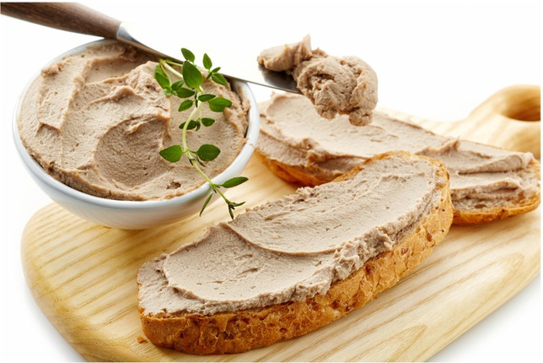
Foods to avoid in pregnancy
Foods to avoid in pregnancy | Rationale
All types of meat, fish or vegetable pâté. | These provide an ideal environment for harmful bacteria to grow, such as listeria. In rare cases this can lead to miscarriage, stillbirth or severe illness in a newborn baby or its mother.

Slide 12
Foods to avoid in pregnancy
Foods to avoid in pregnancy | Rationale
Raw or undercooked fresh or processed meat. There should be no trace of pink or blood. Check cold meats such as salami and chorizo to see if they have been cooked and avoid if they have just been cured or fermented. | otential risk of toxoplasmosis if not thoroughly cooked. Toxoplasmosis is an infection caused by a parasite found in raw or uncooked meat, unpasteurised goats milk, cat faeces and untreated water. It can cause harm to the baby, although it is very rare.
Liver or products containing liver such as haggis and pâté. | High levels of vitamin A in pregnancy can cause congenital birth defects.
Game shot with lead pellets. | Lead can cause developmental problems in a baby.

Slide 13
Foods to avoid in pregnancy
Foods to avoid in pregnancy | Rationale
Shark, swordfish and marlin when pregnant or planning to get pregnant. Limit tuna to no more than two (140–70g) tuna steaks per week or four medium tins of tuna per week. No more than two portions of oily fish per week such as salmon, sardines and mackerel. | Because of the high levels of mercury, this can cause developmental issues and potential brain damage.

Slide 14
Foods to avoid in pregnancy
Foods to avoid in pregnancy | Rationale
Raw shellfish such as mussels, clams, prawns and scallops. Raw fish in sushi is fine to eat, as long as it has been frozen first to kill off harmful bacteria. | May contain harmful bacteria and viruses that can cause food poisoning.
Raw, unpasteurised or non-UHT dairy such as milk, cream and cheese. | These provide an ideal environment for harmful bacteria to grow, such as listeria. In rare cases this can lead to miscarriage, stillbirth or severe illness in a newborn baby or its mother.

Slide 15
Foods to avoid in pregnancy
Foods to avoid in pregnancy | Rationale
No more than 200mg of caffeine per day. | High levels of caffeine have been associated with babies having a low birth weight.
Alcohol. | The Chief Medical Officers for the UK recommend that alcohol is avoided in pregnancy to keep the risk to an unborn baby to a minimum, as the baby’s liver is unable to process alcohol in the way that an adult’s can.

Slide 16
Pregnancy supplements
Supplement | Rationale
Folic acid. | Consume 400mg each day to prevent spina bifida (consume if thinking of getting pregnant and up the end of the first trimester).
Vitamin D (oily fish, Lion Code eggs, cooked red meat and hard cheese). | Strong bones and teeth of both mother and the growing foetus.

Slide 17
Supplements that may be prescribed
Supplement | Rationale
Vitamin C | Aids the absorption of iron from foods and keeps cells healthy. Oranges, potatoes, sweet peppers, berries, broccoli, etc.
Iron | A deficiency can lead to tiredness and possible anemia. Cooked red meat, leafy green vegetables, dried fruit and nuts.
Calcium | Vital for strong bones and teeth. Milk, hard cheese, calcium set tofu, green leafy veg, nuts, dried fruit, fortified rice and oat drinks cereals and bread fortified with calcium.
WARNING!........Large amounts of vitamin A can harm an unborn baby.
Non-pregnant multivitamins should be avoided for this reason.

Slide 18
Hydration
Activity
Discuss and note down the importance of hydration for pre and postnatal clients.

Slide 19
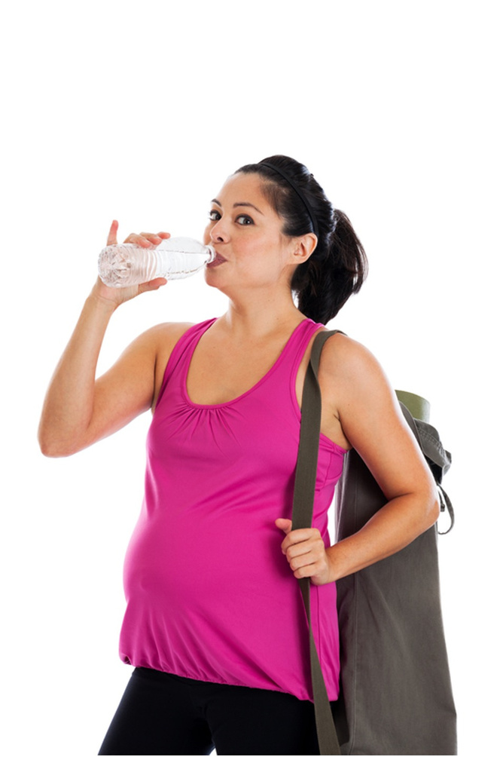
Hydration
Drinking 8–12 glasses of water per day will: Help to flush waste products from cells. Aid kidney and liver function. Aid the increase in maternal blood volume. Prevent constipation. Prevent risk of pre-term labour and possible miscarriage due to dehydration. Prevent fatigue and tiredness. Aid breast milk production.
Drinking 8–12 glasses of water per day will: Help to flush waste products from cells. Aid kidney and liver function. Aid the increase in maternal blood volume. Prevent constipation. Prevent risk of pre-term labour and possible miscarriage due to dehydration. Prevent fatigue and tiredness. Aid breast milk production.
Drinking 8–12 glasses of water per day will: Help to flush waste products from cells. Aid kidney and liver function. Aid the increase in maternal blood volume. Prevent constipation. Prevent risk of pre-term labour and possible miscarriage due to dehydration. Prevent fatigue and tiredness. Aid breast milk production.
Drinking 8–12 glasses of water per day will: Help to flush waste products from cells. Aid kidney and liver function. Aid the increase in maternal blood volume. Prevent constipation. Prevent risk of pre-term labour and possible miscarriage due to dehydration. Prevent fatigue and tiredness. Aid breast milk production.
Drinking 8–12 glasses of water per day will: Help to flush waste products from cells. Aid kidney and liver function. Aid the increase in maternal blood volume. Prevent constipation. Prevent risk of pre-term labour and possible miscarriage due to dehydration. Prevent fatigue and tiredness. Aid breast milk production.

Slide 20
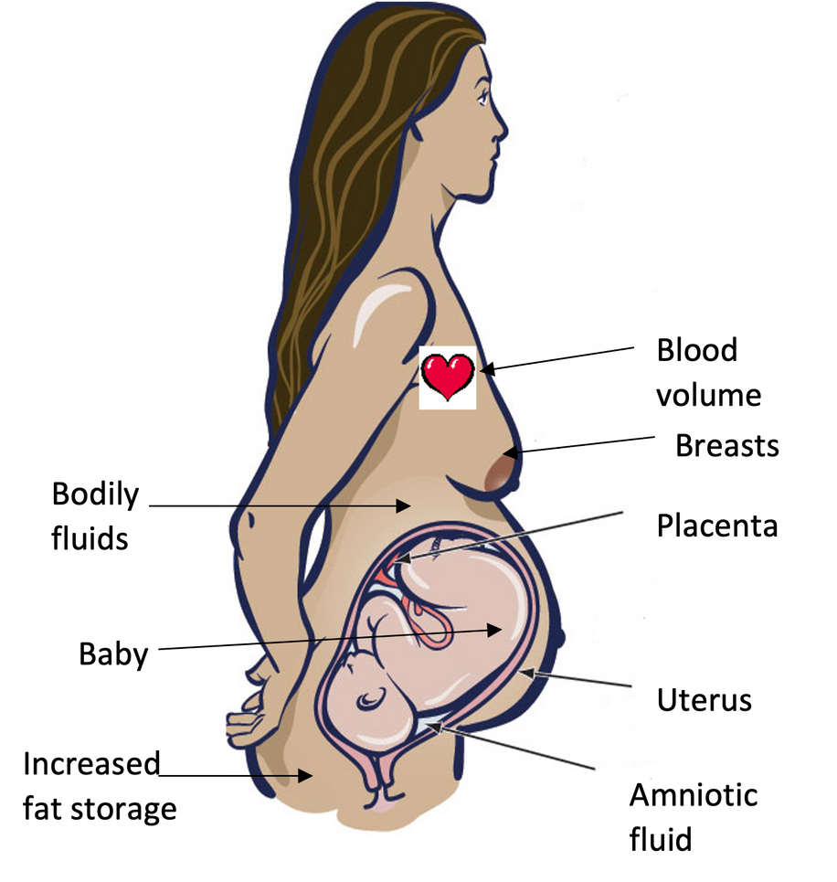
Pre-natal weight distribution at full term

Slide 21
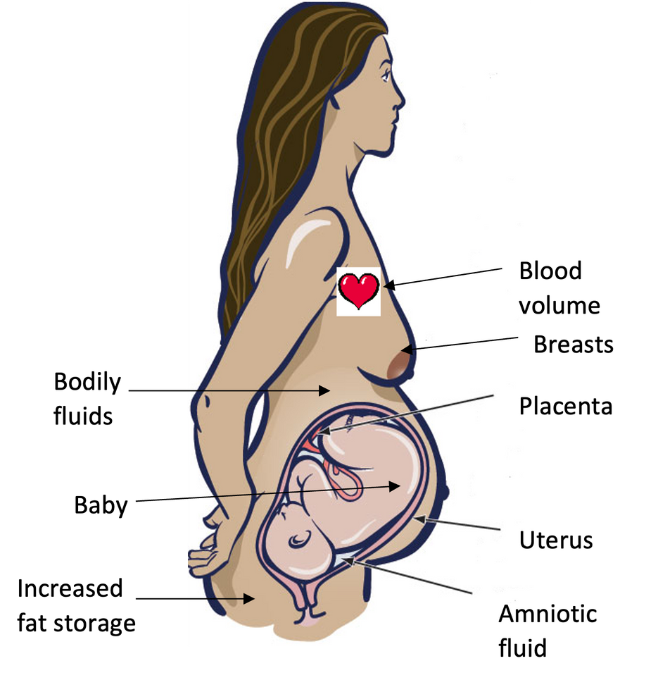
Approximate total weight gain at full term
Total approximate weight gain is 10–12.5kg

Slide 22
Maternal caloric needs
Trimester | Caloric needs
Trimester 1 & 2 | No extra calories
Trimester 3 | Extra 200 calories
Postnatal | Extra 500 calories if breastfeeding

Slide 23
Learning review
Can you now:
Explain the importance of a balanced diet for pre and postnatal clients?
Identify important food sources and explain their value to pre and postnatal clients?
Identify foods to be avoided during pregnancy, and explain the reasons why they should not be consumed?
List the vitamin and mineral supplements recommended in pregnancy and explain the benefits of each?
Explain the importance of hydration for pre and postnatal clients?

