Slide 1

Instructing exercise with referred clients
LO: Adapting exercise to meet client needs

Slide 2

Assessment criteria
Explain why it is important to monitor individual progress if more than one client is involved in the session
Describe different methods of monitoring clients’ progress during exercise, including groups of clients
Explain when it may be necessary to adapt planned exercises to meet client needs
Explain how to adapt exercise/exercise positions as appropriate to individual clients and the environment
Explain how to modify the intensity of exercise according to the needs and responses of the client

Slide 3
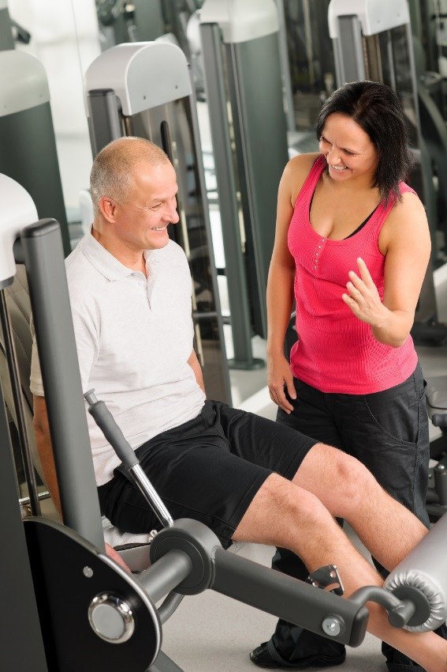
Activity
What skills and qualities would an instructor need to instruct and supervise exercise referral sessions?

Slide 4

Skills and qualities
Subject knowledge
Communication skills
Ability to motivate
Professional
Approachable
Empathy
Positive attitude

Slide 5
Instruction skills
Accurate demonstration
Effective explanation – clear, concise and simple
Use of teaching sequences, IDEA and NAMSET
Observation skills
Ability to motivate
Use of voice – tone, volume, projection
Give teaching points – immediate and timely
Accessible language
Motivational and positive feedback
Modifications for all exercises
Use of body language, e.g. visual cues and expressions

Slide 6

Activity
Explain why it is important to monitor individual progress if more than one client is involved in the session

Slide 7
Monitoring progress
To ensure all clients:
exercise safely
exercise effectively
receive equal attention and guidance
are treated fairly
are supported and encouraged
Monitor client response to exercise

Slide 8
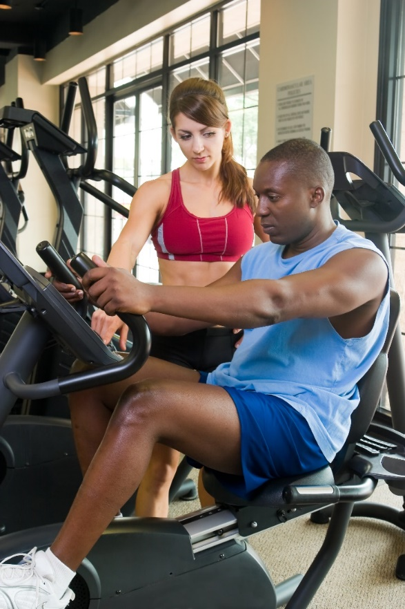
Activity
Describe different methods of monitoring clients’ progress during exercise, including groups of clients

Slide 9
Methods of monitoring during exercise
Observation
Change of teaching position
Question and answer
Talk test
Rating of perceived exertion
Heart rate monitoring

Slide 10
Monitoring exercise safety
Observation
Change teaching position
Use of teaching points:
  Exercise specific
  Joint alignment, movement speed and posture
  Client performance and alignment
Frame feedback positively
Reinforce feedback regularly
Praise effective performance
Offer adaptations, e.g. range of motion, resistance, repetitions

Slide 11
Monitoring intensity
Observation:
Look for changes to:
Posture, alignment, exercise technique
Coordination
Facial expressions (discomfort, pain)
Skin colour (pallor around the lips)
Sweating
Limitations:
Subjective
Need observation skills
General gauge of fatigue
Quick and easy to use.
Immediate

Slide 12

The talk test
Light - able to speak easily and light breathing, increased heart rate.
Moderate –speaking comfortably, deeper and quicker breathing.
Vigorous – speaking with more difficulty; breathing much deeper and heavier; at high levels of intensity - shortness of breath; an inability to carry on a conversation.
Easy to use.
No equipment needed

Slide 13
Rating of perceived exertion
Two scales:
Original scale - 6 to 20
  Corresponds to heart rates ranging from 60-200 bpm.
  Aerobic work between 12 and 13
Modified CR10 scale - 0 to 10
  More user-friendly approach
  Aerobic work between 4 and 7
Client will need to be taught how to use scales.
0-10 is more user friendly

Slide 14
RPE 6-20 scale
Heart rate | RPE | Classification
60-80 bpm | 6-8 | Nothing
<90 bpm | <9 | Very light
~ 100 – 110 bpm | 10 - 11 | Light
~ 120 – 130 bpm | 12 - 13 | Moderate
~ 140 – 160 bpm | 14 - 16 | Heavy
>160 bpm | >16 | Very heavy

Slide 15
RPE 0-10 scale
Nothing | 0 | Warm-up / cool-down
Very, very weak | 0.5
Very weak | 1
Weak | 2
Moderate | 3
Somewhat hard | 4 | Aerobic zone
 | 5
Strong | 6
Very hard | 7
 | 8 | High-intensity intervals – anaerobic zone
Very, very hard | 9

Slide 16

Heart rate monitoring
Manual pulse monitoring - wrist or neck
Heart rate monitor
Maximal heart rate (MHR or HR max) equation:
220 beats per minute (bpm) minus age (220 – age)
Target heart rate (THR) around 50-90% of MHR depending on fitness
Not appropriate for clients using some medication.
Need skill to become proficient at manual monitoring.

Slide 17
Target heart rate (THR)
50-90% of MHR
Calculated by multiplying the MHR by percentage:
x 0.5 (50% THR) – lower THR zone
X 0.6 (60% THR)
X 0.7 (70% THR)
X 0.8 (80% THR)
X 0.9 (90% THR) - upper THR zone

Slide 18
ACSM intensity levels
Heart rate zones
Moderate intensity: 50-65% of MHR.
Vigorous intensity: 65-90% of MHR.
ACSM (2014).

Slide 19
Heart rate zones
MHR | Maximal intensity | Anaerobic
90% | Vigorous intensity | Anaerobic threshold Lactate accumulation in the blood increases
80% | Vigorous intensity
70% | Vigorous intensity
60% | Moderate intensity | Aerobic

Slide 20
Progress markers
Exercise technique
Exercise start positions, e.g. level of support or balance
Equipment used and skill required
Intensity - repetitions, resistance, sets, rests, range of motion
Work and rest ratios for cardiovascular training
Heart rate - % of THR
Walking or cycling pace and level of resistance (for CV machines) Level or incline (CV machines)
Total workout time

Slide 21
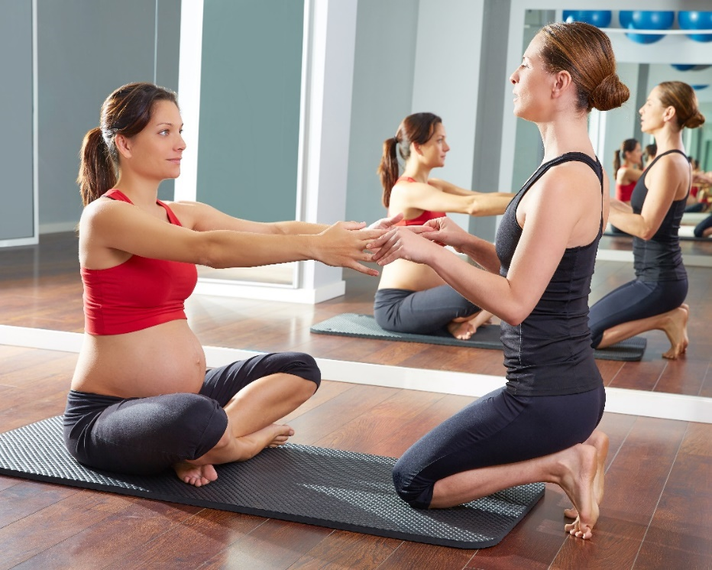
Activity
Explain when it may be necessary to adapt planned exercises to meet client needs

Slide 22
When to adapt
Change in client symptoms or condition
Client returning after a break from exercise, e.g. holiday, hospital or symptoms flare-up
Client finding exercise difficult or easy
Client is unable to maintain correct technique
To improve client enjoyment
Client requests different exercise
To assist balance
To assist range of motion
Equipment in use
Lack of space in environment
Temperature in environment

Slide 23

Activity
Explain how to adapt exercise/exercise positions as appropriate to individual clients and the environment
Explain how to modify the intensity of exercise according to the needs and responses of the client

Slide 24
How to adapt
Training principles and variables - Frequency, intensity, time, type
Equipment used (if any)
Exercise positions
Component of fitness trained
Level of weight-bearing
Stability and balance of exercise start positions
Level of impact – low impact
% of target heart rate
Positions - stability - balance
Level of coordination and complexity

Slide 25
How to adapt
Intensity
  Resistance – lower
  Repetitions and sets – reduce
  Rate/speed – slower
  Range of motion – smaller or supported
  Training approach – simple sets or circuit
  % of target heart rate – low to moderate
Time
  Total workout time
  Duration of components
  Duration of work and rest intervals
Type
  Equipment used
  Component of fitness trained
  Specific activity/training mode

Slide 26
Learning check
Explain why it is important to monitor individual progress if more than one client is involved in the session
Describe different methods of monitoring clients’ progress during exercise, including groups of clients
Explain when it may be necessary to adapt planned exercises to meet client needs
Explain how to adapt exercise/exercise positions as appropriate to individual clients and the environment
Explain how to modify the intensity of exercise according to the needs and responses of the client

