Slide 1
Lesson 2 - Physiological and biomechanical changes in pregnancy

Slide 2
Learning objectives
By the end of the lesson you will be able to:
Identify the duration of the three trimesters
Describe the physiological and biomechanical changes associated with each trimester
Explain the implications of these changes for the client taking part in physical activity

Slide 3
Stages of Pregnancy
Thought storm
Can you state the duration of the three trimesters in weeks?

Slide 4
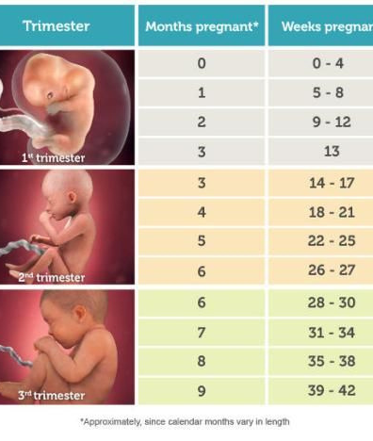
Stages of pregnancy
First trimester: 0-13 weeks
Second trimester: 14-27 weeks
Third trimester: 28-42 weeks.
Note: There are varying sources for this which state different week numbers, please use these ones for your worksheet.

Slide 5
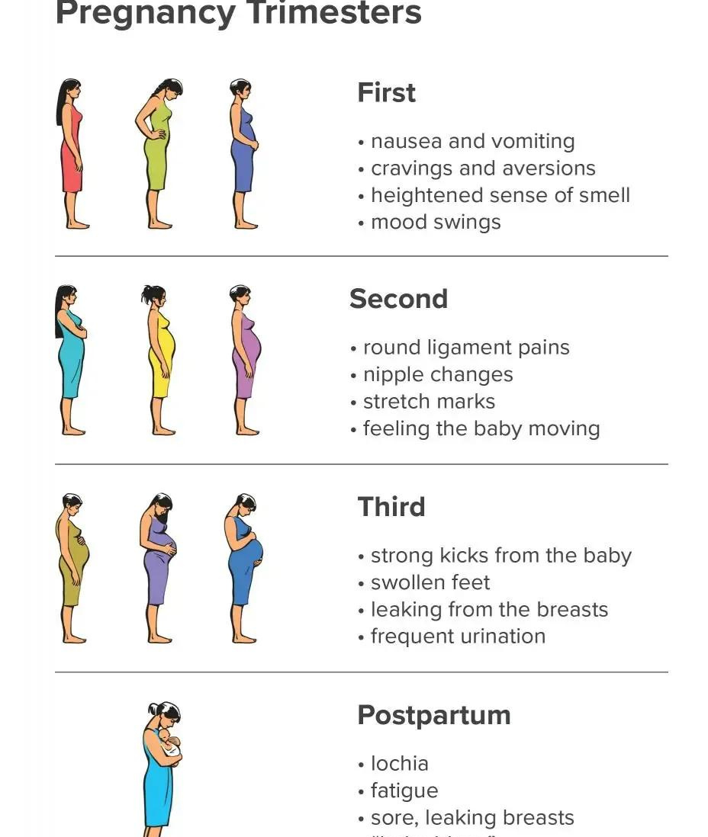
Stages of pregnancy
Each trimester brings a new set of to the mother, including physiological and biomechanical changes to the:
Circulatory system
Respiratory system
Musculoskeletal system
Metabolic and hormonal systems

Slide 6
Circulatory changes in pregnancy
Circulatory changes in pregnancy | Potential symptoms of these changes
Vasodilation - blood vessels enlarge | Waves of fatigue. A racing pulse. Nausea. Pallor. Sweating. Dizziness, especially when getting up and down quickly (potential for postural hypotension). Blood pressure may increase higher than normal during activities such as: Long isometric muscle contractions. Heavy weight training. Holding the breath.
Blood volume increases by up to 50% | Waves of fatigue. A racing pulse. Nausea. Pallor. Sweating. Dizziness, especially when getting up and down quickly (potential for postural hypotension). Blood pressure may increase higher than normal during activities such as: Long isometric muscle contractions. Heavy weight training. Holding the breath.
Vascular underfill | Waves of fatigue. A racing pulse. Nausea. Pallor. Sweating. Dizziness, especially when getting up and down quickly (potential for postural hypotension). Blood pressure may increase higher than normal during activities such as: Long isometric muscle contractions. Heavy weight training. Holding the breath.
Increase cardiac output 20-40% | Waves of fatigue. A racing pulse. Nausea. Pallor. Sweating. Dizziness, especially when getting up and down quickly (potential for postural hypotension). Blood pressure may increase higher than normal during activities such as: Long isometric muscle contractions. Heavy weight training. Holding the breath.
Increase in stroke volume | Waves of fatigue. A racing pulse. Nausea. Pallor. Sweating. Dizziness, especially when getting up and down quickly (potential for postural hypotension). Blood pressure may increase higher than normal during activities such as: Long isometric muscle contractions. Heavy weight training. Holding the breath.
Increase in maternal heart rate 10-20bpm. | Waves of fatigue. A racing pulse. Nausea. Pallor. Sweating. Dizziness, especially when getting up and down quickly (potential for postural hypotension). Blood pressure may increase higher than normal during activities such as: Long isometric muscle contractions. Heavy weight training. Holding the breath.

Slide 7
Circulatory changes in pregnancy
Circulatory changes in pregnancy | Potential symptoms of these changes
Increase in red blood cells 20-30% | Waves of fatigue. A racing pulse. Nausea. Pallor. Sweating. Dizziness, especially when getting up and down quickly (potential for postural hypotension). Blood pressure may increase higher than normal during activities such as: Long isometric muscle contractions. Heavy weight training. Holding the breath.
Increase in size of left ventricle up to 20% | Waves of fatigue. A racing pulse. Nausea. Pallor. Sweating. Dizziness, especially when getting up and down quickly (potential for postural hypotension). Blood pressure may increase higher than normal during activities such as: Long isometric muscle contractions. Heavy weight training. Holding the breath.
Decrease in vascular resistance | Waves of fatigue. A racing pulse. Nausea. Pallor. Sweating. Dizziness, especially when getting up and down quickly (potential for postural hypotension). Blood pressure may increase higher than normal during activities such as: Long isometric muscle contractions. Heavy weight training. Holding the breath.

Slide 8
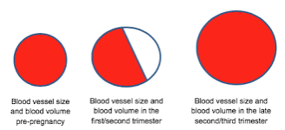
Vascular underfill

Slide 9
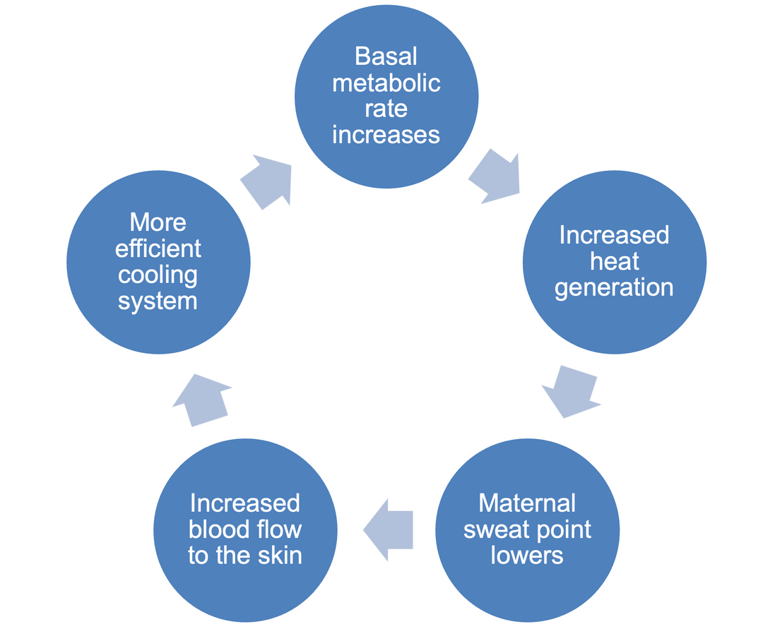
Body temperature changes in pregnancy
Prolonged high-intensity exercise, in hot and humid conditions, may still cause overheating, despite the maternal adaptations to body temperature.
It is important to consider layered clothing, availability of drinking water, ventilation and use the talk test to monitor exercise intensity.

Slide 10
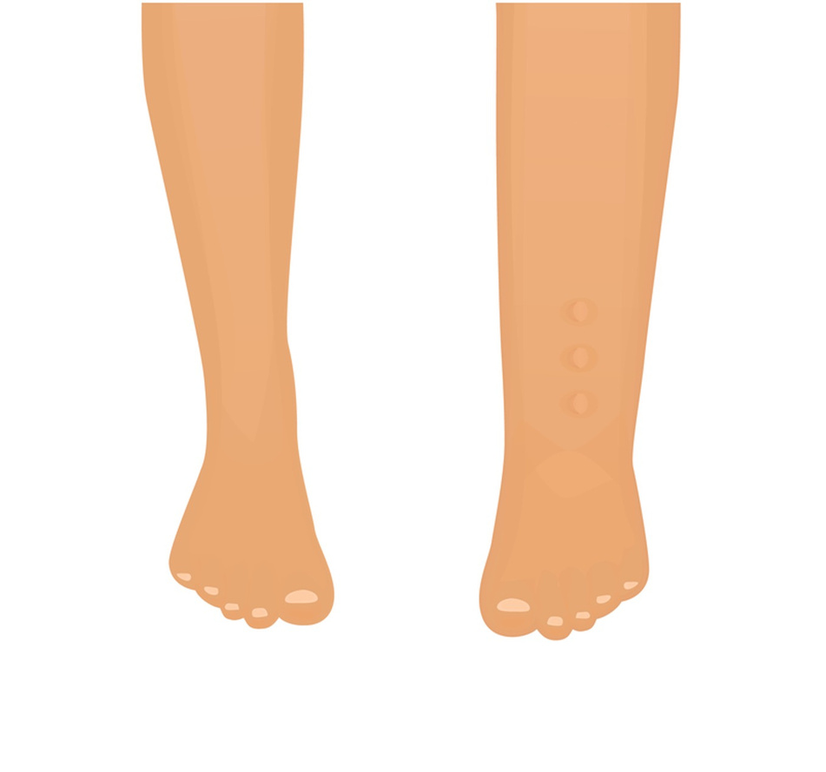
Water metabolism in pregnancy
Growing womb
Affects blood flow
Results in NORMAL leg and ankle swelling
Note: This is also due to a slowing down of the lymphatic system.

Slide 11
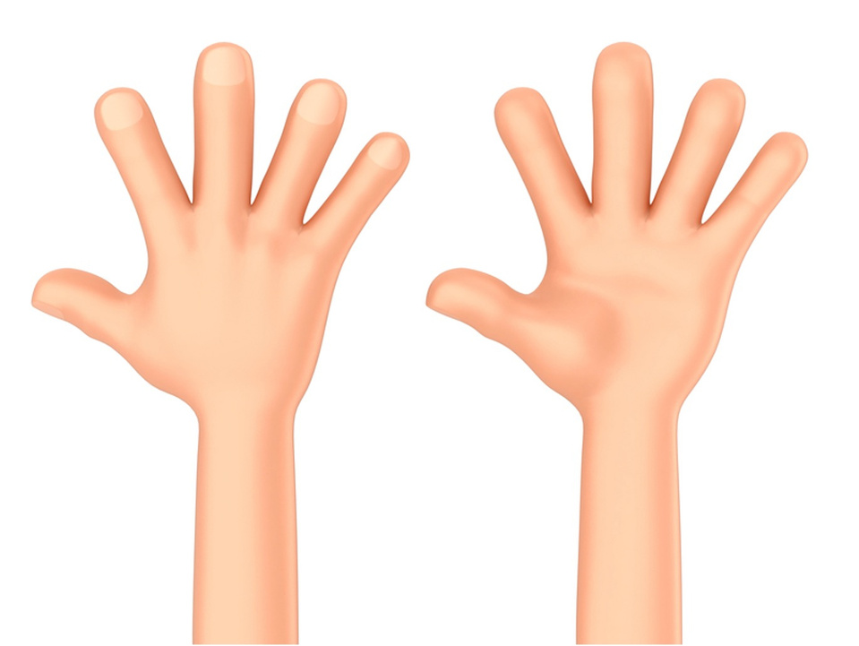
Carpal tunnel syndrome
Numbness and tingling in the hands and thumb may be a symptom of carpal tunnel syndrome.
This can be caused by pressure on the median nerve due to a build-up of fluid in pregnancy.
This can affect grip and cause some discomfort.

Slide 12
Respiratory changes in pregnancy
Respiratory changes in pregnancy | Potential symptoms of these changes
Airways dilate and relax as a result of the effects of progesterone. | Reflux or indigestion. 'Faulty breathing’ through chest or belly. Muscle fatigue when exercising at high intensity. Breathlessness at rest and with exertion (this could also be a sign of iron deficiency).
Increase minute volume 40-50% | Reflux or indigestion. 'Faulty breathing’ through chest or belly. Muscle fatigue when exercising at high intensity. Breathlessness at rest and with exertion (this could also be a sign of iron deficiency).
Diaphragm moves up by 4cm by 37 weeks | Reflux or indigestion. 'Faulty breathing’ through chest or belly. Muscle fatigue when exercising at high intensity. Breathlessness at rest and with exertion (this could also be a sign of iron deficiency).
Increase in ribcage expansion due to the effects of relaxin | Reflux or indigestion. 'Faulty breathing’ through chest or belly. Muscle fatigue when exercising at high intensity. Breathlessness at rest and with exertion (this could also be a sign of iron deficiency).
Brain becomes more sensitive to CO2 | Reflux or indigestion. 'Faulty breathing’ through chest or belly. Muscle fatigue when exercising at high intensity. Breathlessness at rest and with exertion (this could also be a sign of iron deficiency).
The placenta becomes the breathing 'lung' for the fetus. | Reflux or indigestion. 'Faulty breathing’ through chest or belly. Muscle fatigue when exercising at high intensity. Breathlessness at rest and with exertion (this could also be a sign of iron deficiency).

Slide 13
Respiratory changes in pregnancy
Oxygen supply goes to the fetus first and the mother after, so O2 supply to working muscles may reduce during physical activity. | Reflux or indigestion. 'Faulty breathing’ through chest or belly. Muscle fatigue when exercising at high intensity. Breathlessness at rest and with exertion (this could also be a sign of iron deficiency).

Slide 14
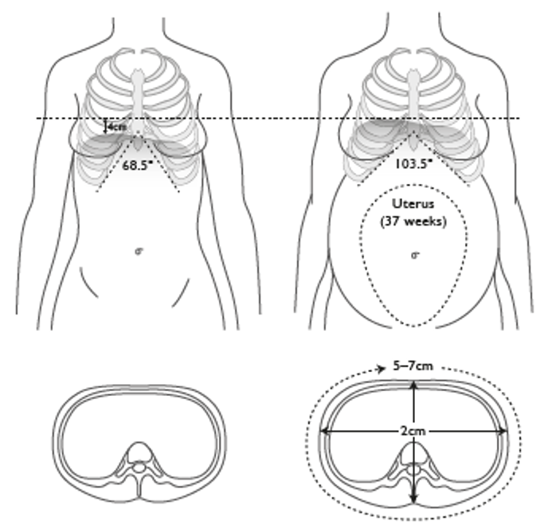
Respiratory changes in pregnancy

Slide 15
Implications for exercise selection
Thought storm:
Consider and note down the implications of the circulatory and respiratory changes for physical activity (consider exercise selection, equipment, position and intensity).

Slide 16
Implications for exercise selection
Changes and symptoms | Implications for exercise
Waves of fatigue, racing pulse, nausea and breathlessness | Moderate intensity, shorter exercise duration; possibly reschedule exercise for another day if fatigue is extreme. Provide longer rest periods between exercises, if required. Encourage good posture and alignment and encourage diaphragmatic breathing.
Postural hypotension or dizziness | Moderate intensity, take time moving from one position to another (e.g. seated to standing). Keep the feet active ti assist venous return.
Potential for blood pressure to increase more quickly than normal. | Avoid heavy weight training, especially overhead, long isometric muscle contractions and holding of breath (Valsalva manoeuvre).

Slide 17
Implications for exercise selection
Changes and symptoms | Implications for exercise
Reflux or indigestion | Avoid decline, supine, semi-supine or prone positions. Keep the head above the stomach.
Carpal tunnel syndrome | May affect grip and ability to extend palms on the floor when four-point kneeling. Gorilla position (closed fists) can be used if comfortable. Good alignment and shoulder stability should help with this.
Water retention. | Avoid long periods of motionless standing. Keep the feet active to assist venous return.
General cardiorespiratory changes | Longer and more gradual warm-up and cool-down.

Slide 18
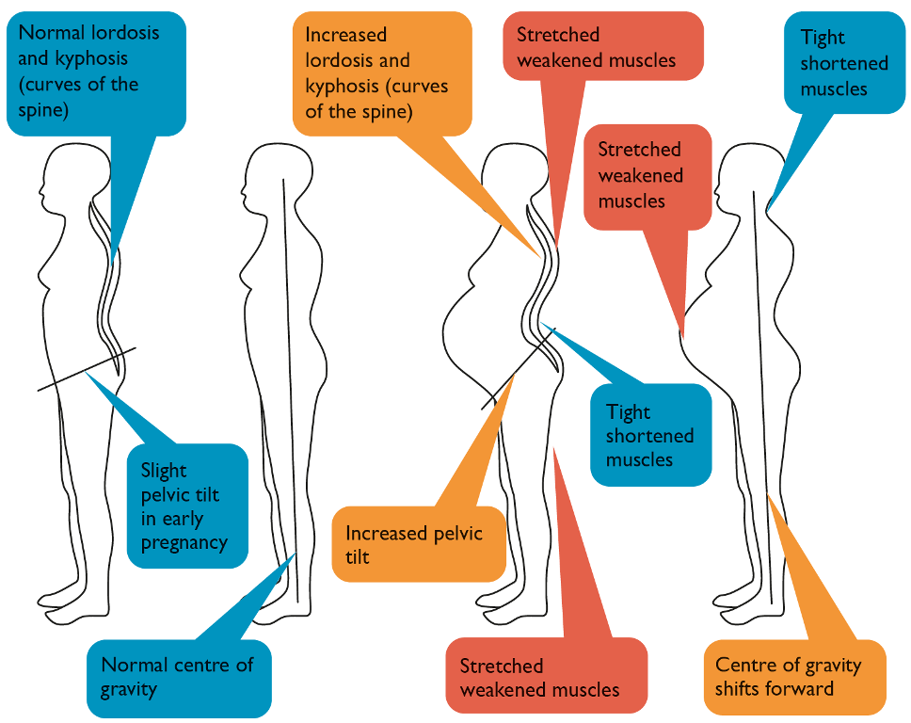
Changes to the musculoskeletal system

Slide 19
Changes to the musculoskeletal system
Activity:
Which groups becomes weaker and underactive?
Which muscle groups become tighter and overactive?

Slide 20
Changes to the musculoskeletal system
Muscles tight and overactive | Muscles weak and underactive
Chest (pec minor affected by weight or growing breasts) and anterior deltoids. | Trapezius, rhomboids, rear deltoids.
Lower back, for example erector spinae | Rectus abdominis. Transversusabdominis. Obliques. Pelvic floor
Hip flexors | Gluteal group and hamstrings.

Slide 21
Changes to the musculoskeletal system
Changes to musculoskeletal system | Potential symptoms of these changes
Centre of gravity moves forward | Affects balance and risk of falling increases.
Growing uterus. Potential for uterus to put pressure on the vena cava in a lying supine or semi-supine or half reclined position. | Weakening of the abdominals and potential for diastasis recti pelvic girdle pain and back pain; affects ability to exercise in a lying prone or supine position. Sometimes the baby can lie on the sciatic nerve causing sciatic symptoms
Weakening of the pelvic floor muscles. | Frequent need to urinate due to pressure on pelvic floor muscles. Can cause haemorrhoids, stress incontinence or prolapse.
Hyperkyphosis. | Rounding of the shoulders, head position moves forward, neck pain.

Slide 22
Changes to the musculoskeletal system
Changes to musculoskeletal system | Potential symptoms of these changes
Hyperlordosis. | Back pain and pelvic pain.
Loosening of ligaments due to relaxin. | Joints become more unstable, range of movement increases, risk of injury, risk of pubis symphysis dysfunction and pelvic pain (PGP).

Slide 23
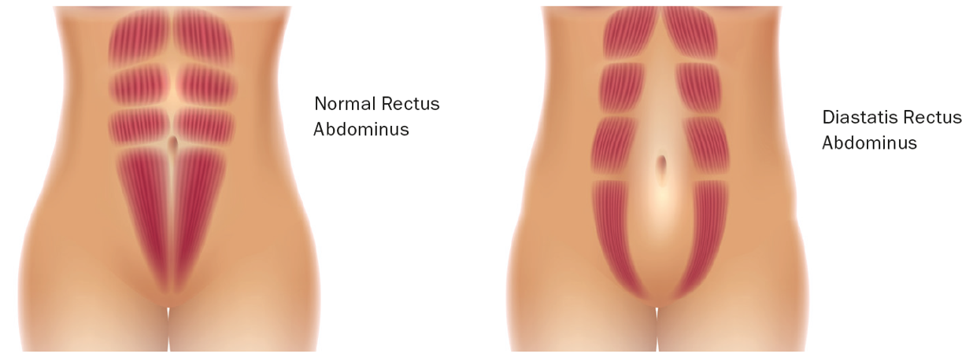
Diastasis recti

Slide 24
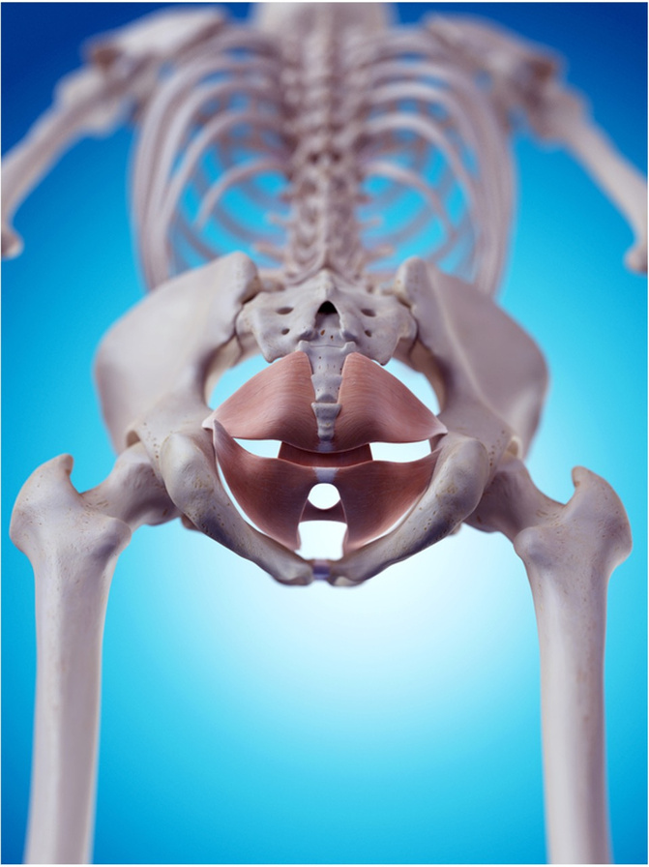
Pelvic floor muscles
Act as a cradle to support the bowel, bladder, uterus and other pelvic organs. . Help the baby to be born. Assist is defecation and urination
Consist of both type 1 (slow twitch) and type 2 (fast twitch) muscle fibres.

Slide 25
Implications for exercise selection
Changes and symptoms | Implications for exercise
Centre of gravity shifts forward | Select more stable exercise positions in the second and third trimesters.
Growing uterus. Potential for uterus to put pressure on the vena cava in a lying supine position. | Avoid lying supine and semi-supine exercises after the first trimester. Use upright, seated or standing exercises instead. Avoid lying prone positions once they become uncomfortable.
Weakening of the pelvic floor muscles. | Instruct pelvic floor exercises and encourage them to be performed daily. These are stopped in third trimester once the baby gets deeper in the pelvis and the woman can no longer feel her PF.

Slide 26
Implications for exercise selection
Changes and symptoms | Implications for exercise
Hyperkyphosis. | Select exercises that strengthen the mid trapezius, rhomboids spinal extensors and rear deltoids. Maintain flexibility of the pectorals and anterior deltoids. Maintain good upper body alignment and stability
Hyperlordosis. | Select exercises that strengthen the abdominals, obliques and gluteal group. Avoid spinal flexion against gravity and uncontrolled rotation of the spine to prevent further weakening of the abdominals. Stretch the lower back and hamstrings.
Loosening of ligaments due to relaxin. | Joints are unstable so avoid high-impact and heavy overhead exercises that put pressure on the musculoskeletal system. Monitor range of movement, hip swing and posture carefully; avoid overstretching.

Slide 27
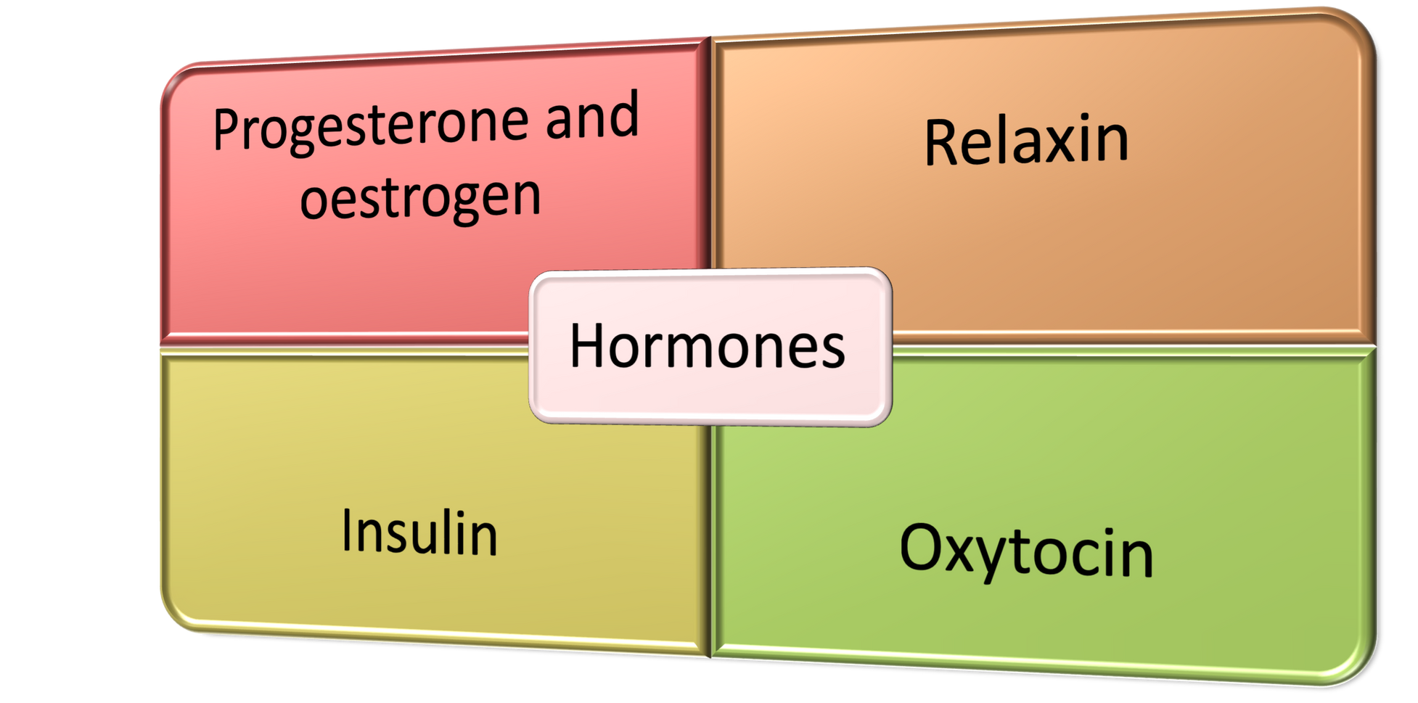
Metabolic and hormonal systems

Slide 28
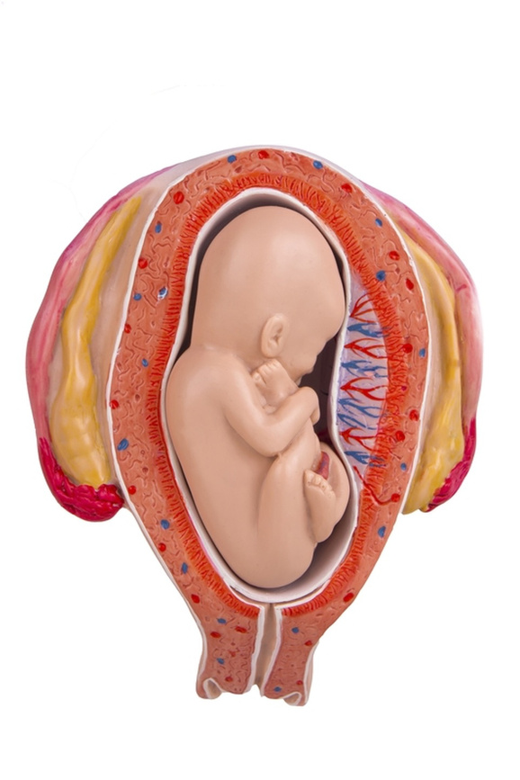
Progesterone and oestrogen
Development of the uterus. | Relax all smooth muscle tissue.
Development of the foetus. | Allow blood vessels and airways to dilate.
Development of the placenta. | Milk duct development.
Growth of maternal breast tissue. | Prevent premature lactation.
Strengthen the wall of the uterus.

Slide 29
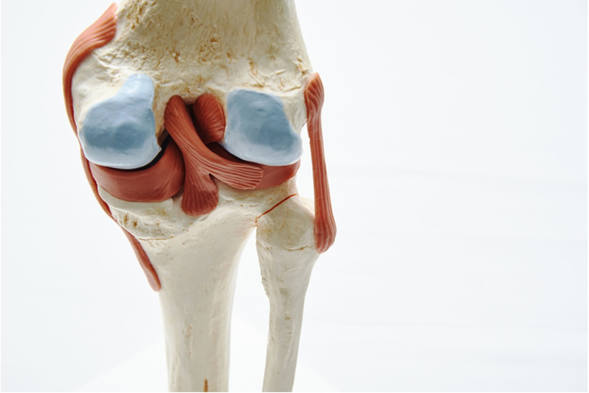
Relaxin
Relaxin loosens ligaments to allow for the following:
The pelvic floor to open up for childbirth.
The ribcage to expand as a result of the growth of the uterus.
However relaxin is not isolated to these areas, it loosens ALL ligaments and soft tissue and creates instability in the whole skeletal system.

Slide 30
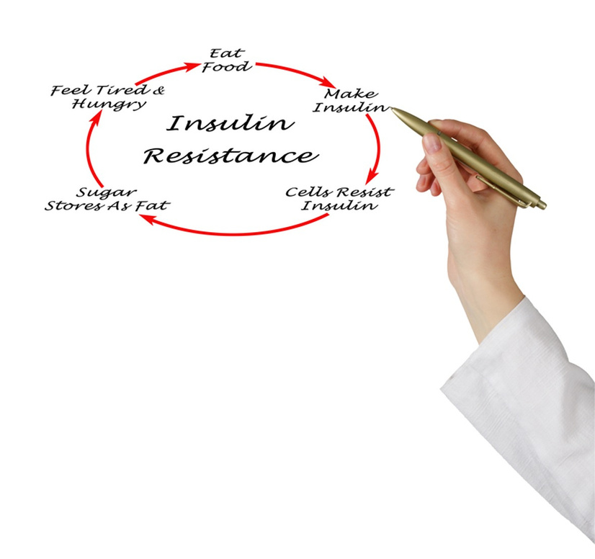
Insulin and gestational diabetes
Insulin resistance increases in pregnancy.
Glucose circulates in the blood for longer to supply the placenta and the baby with energy.
Can lead to gestational diabetes. Women with GD often return to normal after birth.
Exercise increases insulin sensitivity, which may result in low blood sugar if insufficient calories are consumed before and after exercise. A woman can consume a light snack such as yoghurt, fruit and seeds an hour before exercise

Slide 31
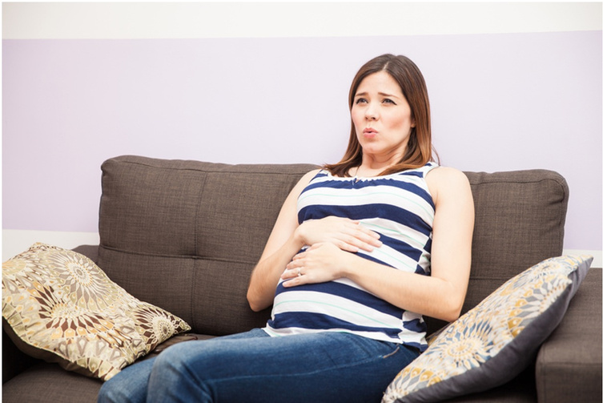
Oxytocin
Aids mother and baby bonding: ‘the love hormone’.
In preparation for delivery, oxytocin:
Dilates and relaxes the cervix.
Aids contraction of the uterus and abdominal muscles.
‘Braxton Hicks’ are NORMAL practice contractions that can start within the second trimester, but are more common in the third trimester. A woman should stop exercising if she experiences Braxton Hicks whilst exercising

Slide 32
Implications for exercise selection
Changes and symptoms | Implications for exercise
Relaxation of smooth muscle due to progesterone can cause indigestion, wind, heartburn, haemorrhoids and constipation. | Avoid decline, semi-supine, supine or prone positions and keep the head above the stomach; use a Swiss ball or cushion for comfort on seated exercises when required.
Mood swings and emotional episodes due to progesterone and oestrogen. | Be sensitive, empathetic and encourage exercise as a mood enhancer.
Loosening of ligaments due to relaxin. | Joints are unstable so avoid high-impact and heavy overhead exercises that put pressure on the musculoskeletal system. Monitor range of movement, hip swing and posture carefully, and avoid overstretching. Encourage exercises that promote joint stability.

Slide 33
Implications for exercise selection
Changes and symptoms | Implications for exercise
Insulin resistance and possible gestational diabetes. | Encourage regular meals to manage blood sugar levels and exercise at a moderate intensity. Encourage a snack one hour before exercise and immediately after exercise. Can cause dry mouth and frequent need to urinate. Possible low blood sugar when exercising at high intensity.
‘Braxton Hicks’ contractions. | Be sensitive, empathetic and encourage rest. Exercise should be stopped. If persistent then refer to a medical practitioner.

Slide 34
Learning review
Can you now:
Identify the duration of the three trimesters?
Describe the physiological and biomechanical changes associated with each trimester?
Explain the implications of these changes for the client taking part in physical activity?

