Slide 1

Professional practice for exercise referral instructors
LO: The exercise referral process

Slide 2

Assessment criteria
Explain the process of receiving a referred patient from a healthcare professional.
Describe the protocol for an initial patient consultation with the exercise referral instructor.
Describe the principles of patient monitoring and data collection.
Outline the medico-legal requirements relevant to the exercise referral instructor job role.

Slide 3

Activity
How are clients referred from a GP or healthcare professional and how do they proceed through an exercise referral scheme?

Slide 4
The referral process
The start of the process is a client visiting their GP.
The GP will have a contracted agreement to work with the named referral scheme.
GP has copies of referral schemes:
  Risk stratification model.
  Inclusion and exclusion criteria.
  Transfer of information records.
  Main contact for transferring information.

Slide 5
Inclusion/exclusion criteria
Determined by:
Instructor qualifications and experience
Level 3 exercise referral = low to moderate risk
  Low risk only schemes
  Low to moderate risk schemes
Access to clinical specialists
Wider range of populations and conditions may be managed
Risk stratification tool used by scheme
Absolute contra-indications – exclusion
Inclusion = Clients who can be referred
Exclusion = Clients who cannot be referred

Slide 6
Information transferred
GP name
Client name
Date
Reason for referral
Client contact details
Summary of medical history – past and current
Medications or other treatments
Risk stratification - PARmedX and other tools
Other relevant information, e.g. cultural needs, language spoken, etc.
Health measurements, e.g. blood pressure, heart rate, BMI (usually taken by practice nurse)
Clients preferred method of contact

Slide 7
Receiving a referred client
Information is passed to named contact - scheme co-ordinator
Contact receives and checks records
Incomplete or inaccurate records returned to GP for more information
Complete and accurate records:
  Client contacted by co-ordinator
  First appointment with exercise referral instructor booked
  Client information passed to instructor

Slide 8
The referral process
Patient visits GP
GP suggests exercise referral (if patient meets criteria)
Informed consent gained
Information transferred to referral scheme
Scheme coordinator
Receives and checks information transferred.
Incomplete records are returned to GP.
Complete records – client is contacted and appointment booked with exercise referral instructor.
Exercise referral instructor
Consultation with client.
Motivational interview and initial assessments.
Programme planned, delivered, monitored (12-16 weeks)
Exit strategies and follow up monitoring (6 /12 months) Scheme evaluation

Slide 9

Activity
What are the appropriate protocols to follow to conduct an initial patient consultation and assessment?

Slide 10
Consultation protocols
Welcome client
Build rapport
Discuss information transferred to check accuracy
Explain initial assessments and their purpose, e.g. blood pressure, heart rate, BMI, EQ-5D, IPAQ, physical assessments
Obtain clients informed consent to participate in assessment
Conduct assessments
Record all information

Slide 11
Consultation protocols
Use motivational interviewing and client-centred approach to assess:
  Client readiness to participate
  Motivation and barriers
  Goals - short, medium and long term
  Activity likes and dislikes
Discuss possible programme (FITT principles) with consideration to client needs
Obtain clients informed consent to participate in the structured exercise
Develop programme
Appropriate inductions (where relevant, e.g. gym)

Slide 12
Informed consent
Explain the purpose of the assessment or programme
Describe the benefits
Explain any possible risks, discomforts and actions to minimise
Explain client responsibilities
  Discuss and emphasise that participation is voluntary
  Discuss confidentiality and privacy
  Provide the opportunity for client questions
  Record all questions and answers
  Sign and date the informed consent record
  Ask the client to sign and date the informed consent record

Slide 13

Activity
What skills build rapport?

Slide 14
Building rapport
Listen.
Motivational Interviewing - OARS
Open questions , e.g. ‘How are you you?’
Affirming statements, e.g. ‘Thank you for joining the scheme’
Reflective listening, e.g. ‘So you hope that exercise will help to improve your mood?’
Summarising, e.g. ‘Your main concern is a lack of fitness and being pushed to work too hard?’

Slide 15
Listen
Their motivation - Change talk (reasons to make changes):
‘I really want to be able to play with my grandchildren’
‘I will be able to climb stairs without getting so breathless’
‘I know I will feel better’
Their barriers - Sustain talk (reasons to not make any changes):
‘I can’t do that because I’m too old.’
‘I’ve never liked exercise’
‘I’m scared I will fail’

Slide 16
Psychological readiness scale
Example question:
Using the 1-10 scale, how ready do you feel to be more active on a regular basis?
Not ready
Why?
100% ready
Why?
1
2
3
4
5
6
7
8
9
10
Example questions:
Why have you indicated you are at level 6 and not a 4?
What would you need to score 8?
What score would you like to be?
How could you move from score 6 to score 7?
Can help to elicit further change talk.

Slide 17

Activity
Describe the principles of patient monitoring and data collection.

Slide 18
Professional & Operational standards
Client data to collect:
Personal - age, gender, ethnicity
Measurements - height, weight and BMI, waist circumference
Health measures - pre-exercise heart rate, blood pressure
Questionnaires - physical activity levels (using IPAQ or 7 day recall) quality of life (using EQ-5D)
Physical - range of joint movement
Other - any other measurements requested by the referring health professional

Slide 19
Professional & Operational standards
Purpose of collecting information/data:
Baseline information
Develop exercise programme
Assist planning of other activities
Monitor client progress
Assist motivation of client
Client education
Identify progression and regression needed
Identify progress and development
Support scheme outcomes
Support funding applications

Slide 20
Monitoring
When to collect:
Initial consultation – baseline
Mid-term review – progress check (6-8 weeks)
End-term review – outcome check
Follow up – post-scheme reviews
  6 month post review – any sustained change?
  12 month post review – any sustained change?

Slide 21
Monitoring
Pre-session checks:
  Any changes in health or symptoms
  Any changes in medication
  Response to previous exercise session, e.g. tiredness, chest pain
  The results/outcomes of any GP appointments and tests
Exercise referral instructor actions:
Temporarily defer client from activity
Explain why and be sensitive
Inform coordinator
Signpost client back to the GP

Slide 22
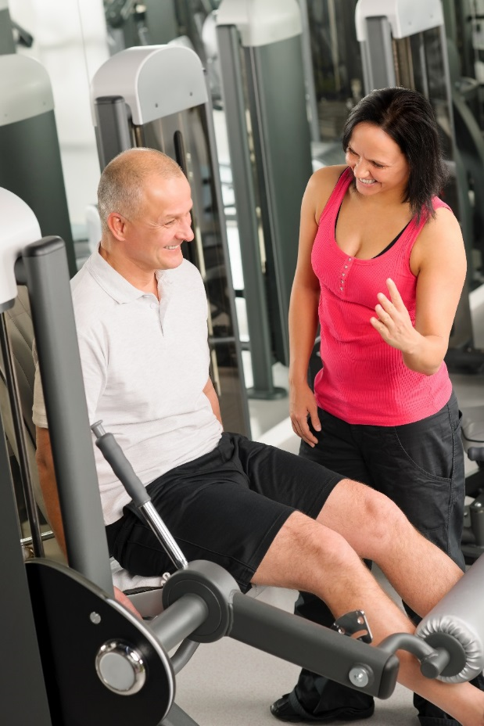
Activity
What are the medico-legal requirements relevant to the exercise referral instructor job role?

Slide 23
Medico-legal requirements
General:
Work within boundary of role and responsibilities (REPs, EHFA)
Comply with codes of practice.
  Only deliver programmes for which qualifications held
  Only work with conditions for which qualifications held
Comply with legislation, e.g. health and safety, equality, data protection, etc.
Follow scheme protocols and professional operational standards
Be qualified
Be insured; be members of appropriate professional organisations

Slide 24
Medico-legal considerations
GP is responsible for the overall management of the patient
Referral by GPs governed by General Medical Council
GP may only refer a patient to professionals who:
  Are accountable to a statutory regulator.
  Work in an environment where there is appropriate supervision, audit and performance review
These criteria are under review.
Unless these criteria are met the transfer of care is considered delegation NOT referral.

Slide 25
Learning check
Explain the process of receiving a referred patient from a healthcare professional.
Describe the protocol for an initial patient consultation with the exercise referral instructor.
Describe the principles of patient monitoring and data collection.
Outline the medico-legal requirements relevant to the exercise referral instructor job role.

