Slide 1
Anatomy and physiology for sports massage
LO9: The structure and function of the respiratory system

Slide 2
Assessment criteria
Describe the structure of the respiratory system
Describe the functions of the respiratory system
Identify the main muscles involved in breathing
Describe the passage of air through the cardiorespiratory systems, including gaseous exchange

Slide 3
The respiratory system
The respiratory system works with the cardiovascular system to ensure the body receives oxygen and removes carbon dioxide.
The respiratory system:
Takes in oxygen from the atmosphere
Releases carbon dioxide into the atmosphere.
The cardiovascular system:
Circulates oxygen to the cells of the body
Collects carbon dioxide from the cells.
All cells need oxygen to survive and perform their various activities.

Slide 4
Respiration
The overall exchange of gases between the atmosphere and the blood.
Involves three processes:
Breathing (pulmonary ventilation) - the process of physically moving air in and out of the lungs
External respiration – the exchange of gases between the lungs and the blood
Internal respiration – the exchange of gases between the blood and the cells of the body

Slide 5
Composition of air
Gas | Inhaled air | Exhaled air | Difference
Nitrogen | 79% | 79% | none
Oxygen | 21% | 17% | ↓ 4%
Carbon dioxide | <1% | 4% | ↑ 4%

Slide 6
Respiratory system structures
The upper respiratory system:
The nose
The mouth
The pharynx
The larynx
The lower respiratory system:
The trachea
The bronchi (right bronchus and left bronchus)
The bronchioles
The alveoli (surrounded by capillaries)

Slide 7
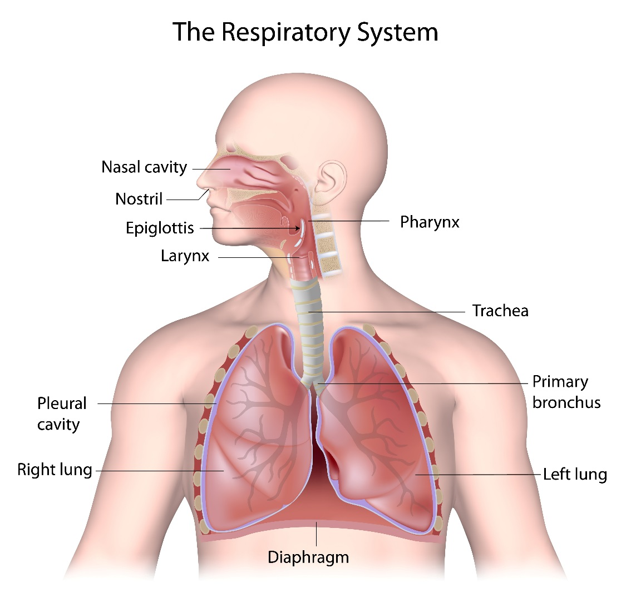
Respiratory system structures
The lungs are located in the rib cage or thoracic cavity

Slide 8
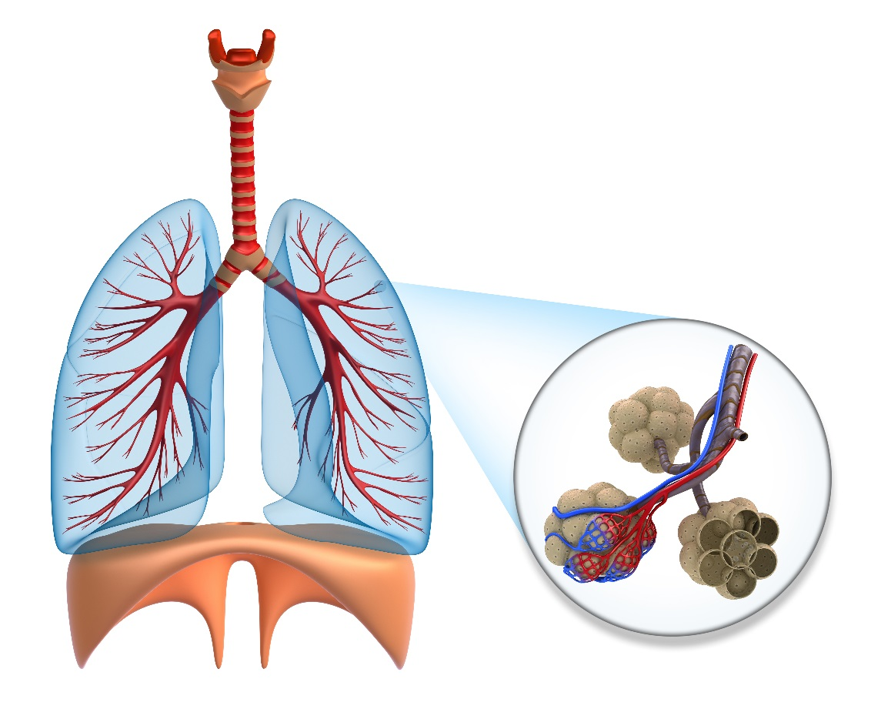
The structure of the lungs
Trachea – windpipe
Bronchi – right and left
Bronchioles
Alveoli – air sacs
Capillaries

Slide 9
Activity
Place your hands on your rib cage.
Breathe in and out.
What happens to the rib cage when you breathe in?
What happens to the rib cage when you breathe out?

Slide 10
Mechanics of breathing
Breathe in - Inspiration.
Rib cage expands
Diaphragm contracts and lowers (descends.
Intercostal muscles contract
Lungs inflate (fill with air)
Breathe out - Expiration.
Rib cage returns to normal
Diaphragm relaxes and rises (ascends)
Lungs deflate (air removed)

Slide 11
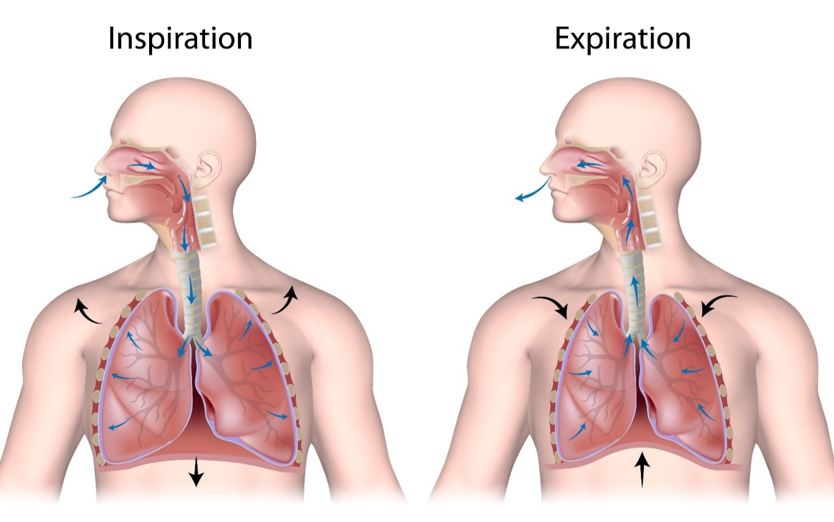
Mechanics of breathing

Slide 12
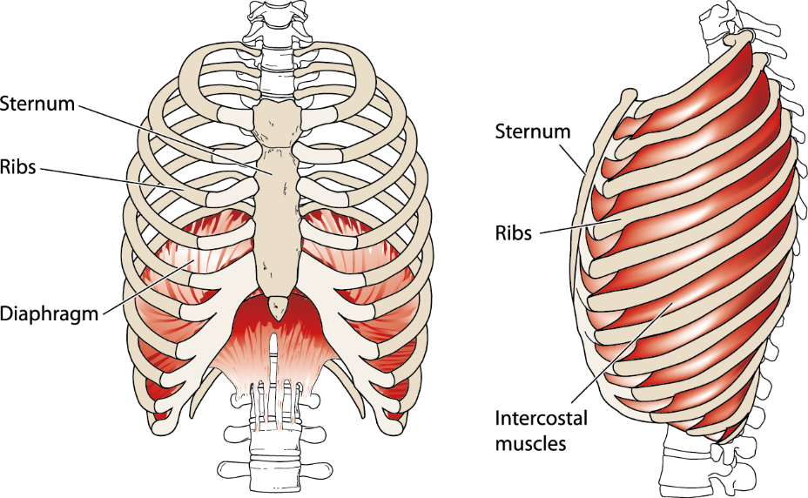
Muscles involved in breathing

Slide 13
Accessory breathing muscles
Help increase intake of oxygen when the demand increases
Abdominals help draw the rib cage down and out
Sternocleidomastoid and scalenes help draw the rib cage up and out

Slide 14
The journey of air to the body
Breathe in.
Nose and mouth
Pharynx and larynx
Trachea
Bronchus, bronchioles
Alveoli
Gaseous exchange in the lungs.
Capillaries
Oxygenated blood circulated from the lungs to the heart
Pulmonary vein enters left atrium, moves to left ventricle
Circulated to body via aorta, arteries, arterioles, capillaries
Oxygen reaches the cells

Slide 15
The journey of air from the body
Gaseous exchange - body cells.
Cells receive oxygen and release carbon dioxide into capillaries
Deoxygenated blood travels to the heart
Venules, veins, vena cava.
Enters the right atrium, moves to right ventricle
Circulated to the lungs
Pulmonary artery, arterioles, capillaries
Gaseous exchange in lungs.
Alveoli receive carbon dioxide from capillaries and release oxygen into capillaries
Bronchioles, bronchus
Larynx, pharynx
Nose and mouth
Breathe out.

Slide 16
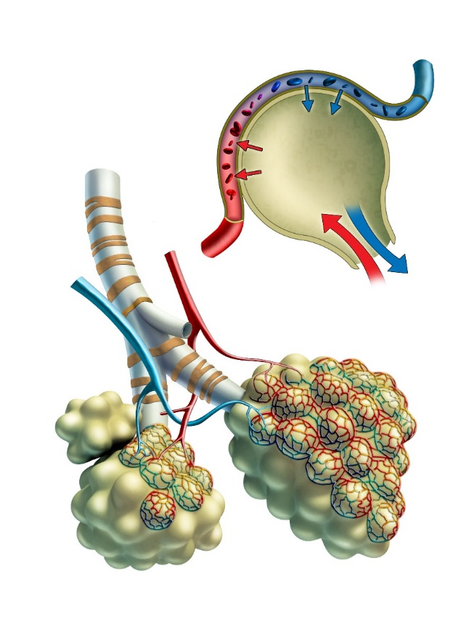
Gaseous exchange in alveoli
Air sacs at the terminal end of bronchioles
Surrounded by capillaries
Site of gaseous exchange
Diffusion of gases

Slide 17
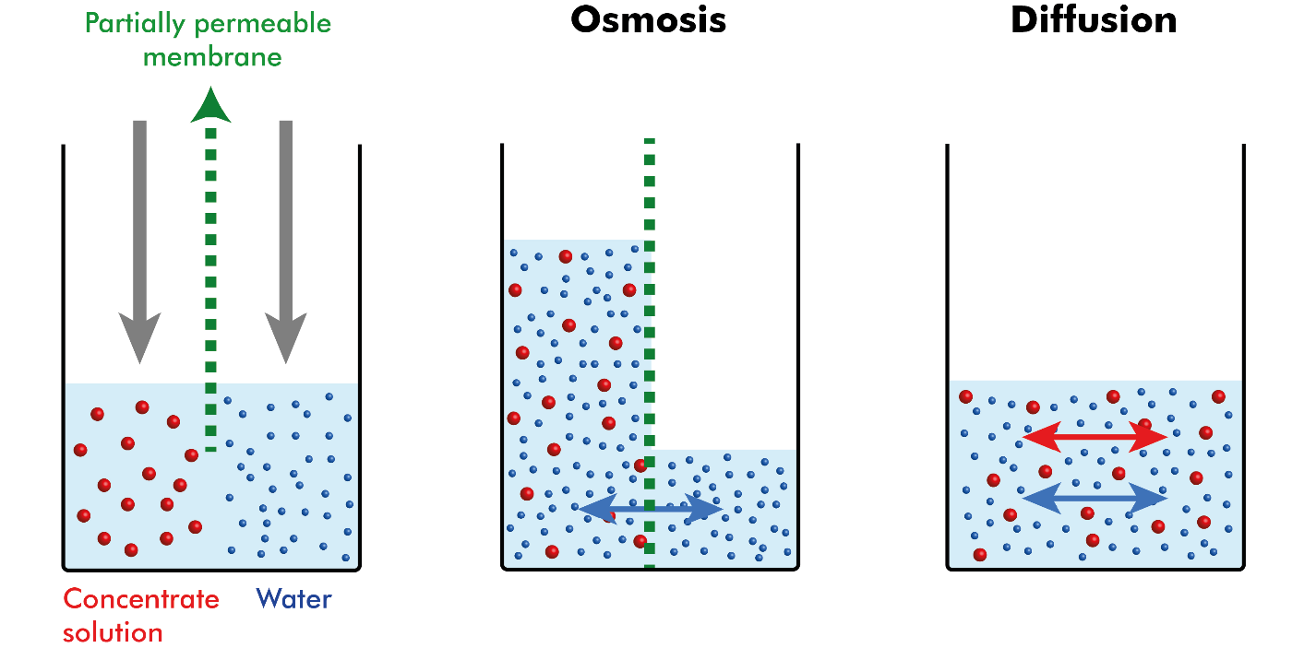
Diffusion
The movement of a substance from an area of high concentration to an area of low concentration.

Slide 18
Gaseous exchange
Blood flow
Capillary
Alveoli
Bronchiole
Bronchiole
To alveoli = CO₂
Alveoli
To capillaries = O₂

Slide 19
Activity
Explain how oxygen enters the body and how it travels around the body
Name the structures of the respiratory systems it will move through

Slide 20
Learning check
Describe the structure of the respiratory system
Describe the functions of the respiratory system
Identify the main muscles involved in breathing
Describe the passage of air through the cardiorespiratory systems, including gaseous exchange

